Slide 1


ArchiMate Modeling using Archi® Tool
00
Opening and Introduction
Based on Sparx Systems’ ArchiMate Introduction

Slide 2
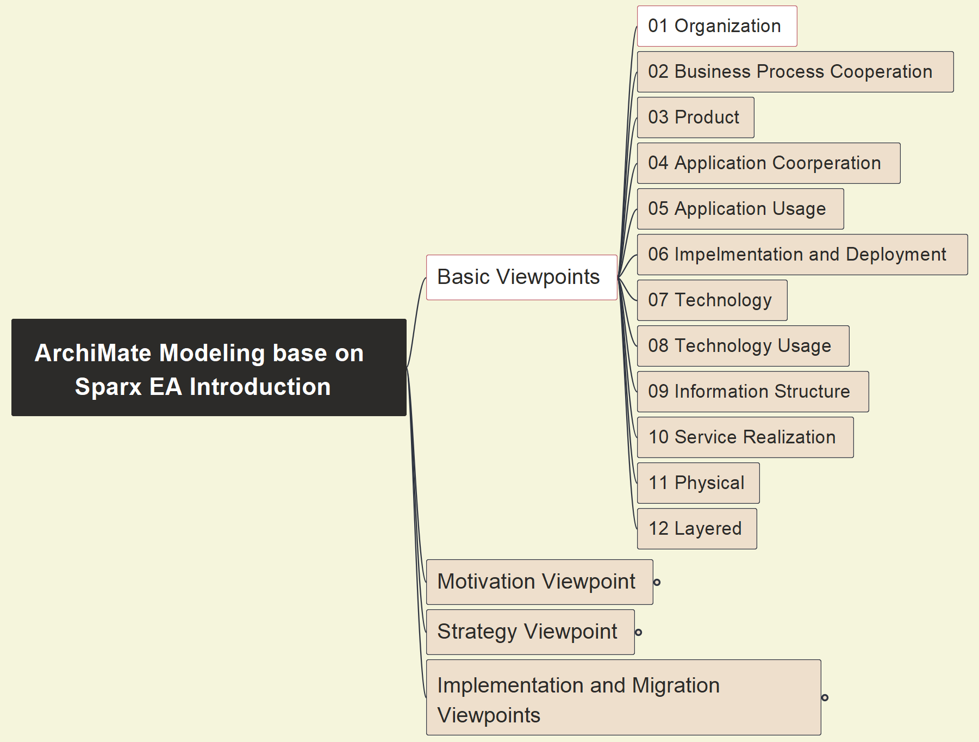
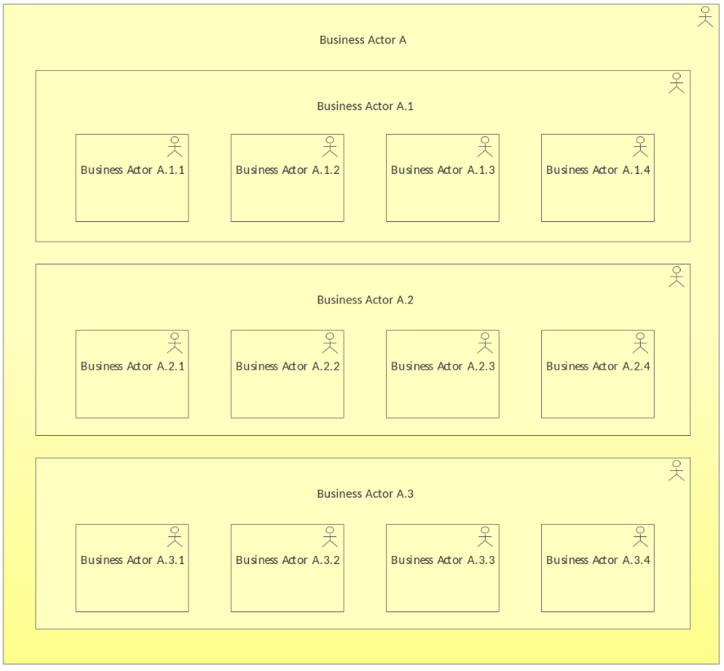
01 Organization - Pattern
01
ArchiMate-Modeling-Tutorial_00_Opening-and-Introduction

Slide 3
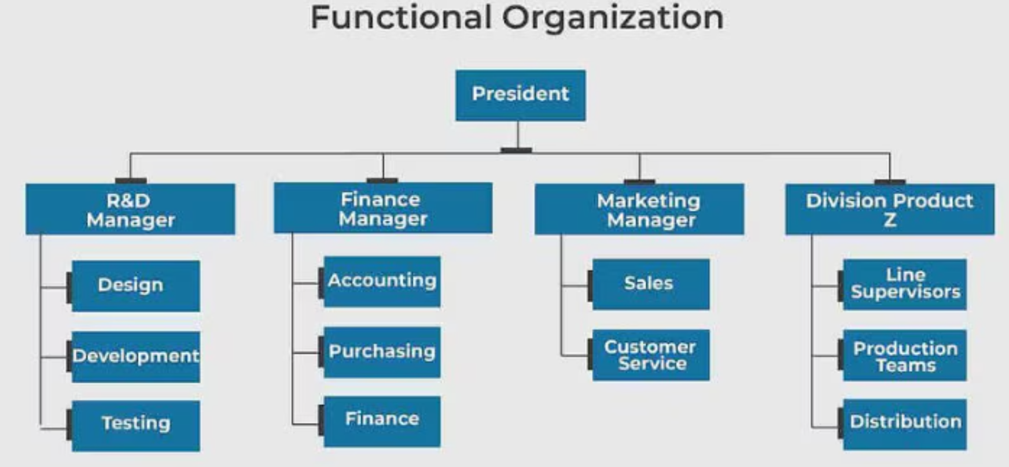
01 Organization - Example
02

Slide 4
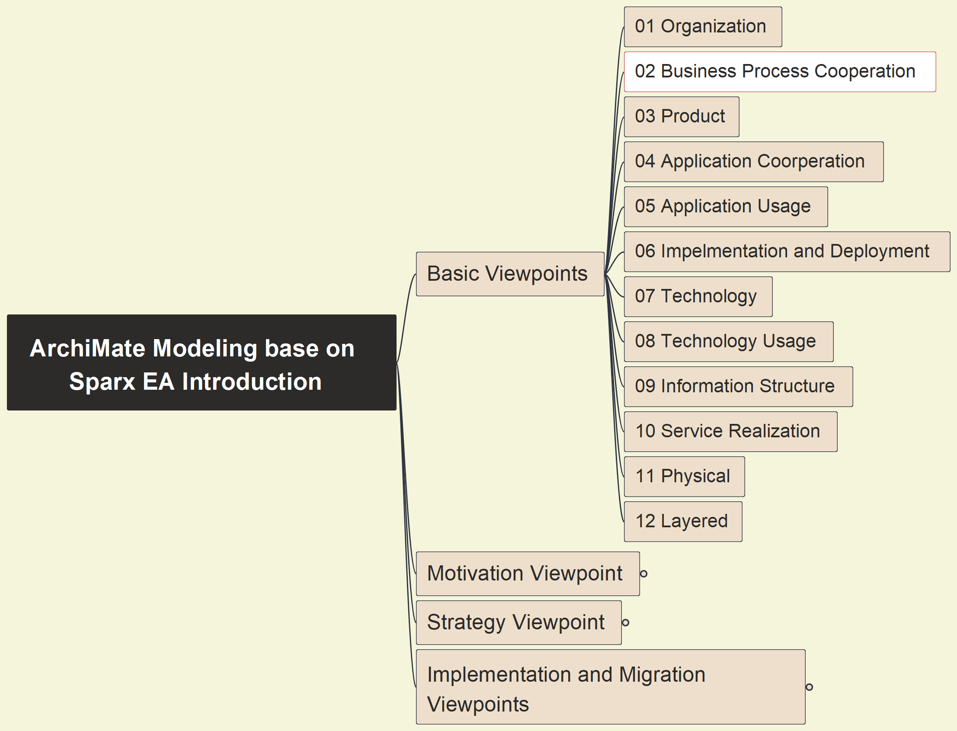
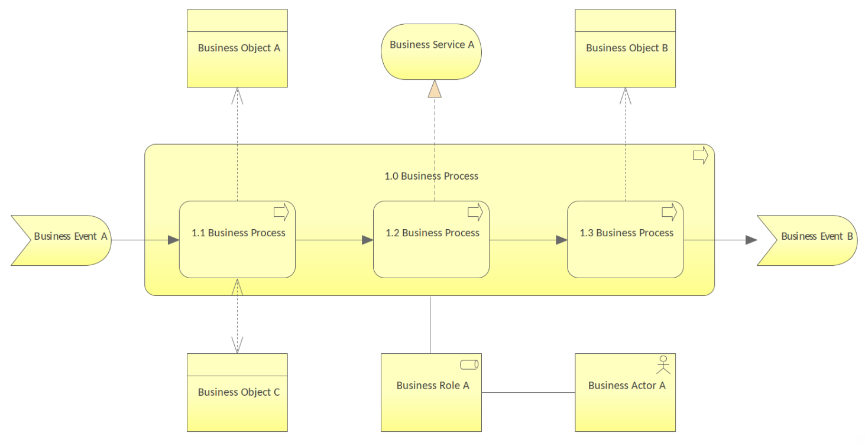
02 Business Process Cooperation - Pattern
03

Slide 5
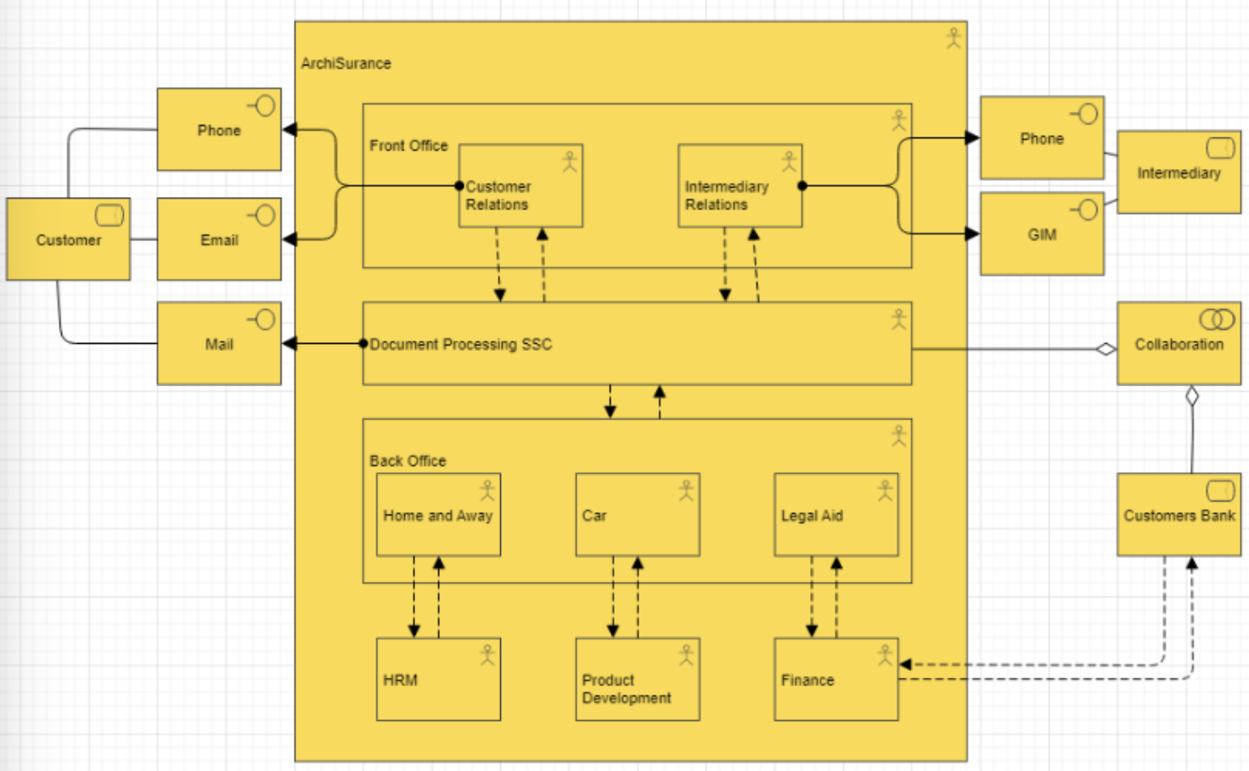
02 Business Process Cooperation - Example
04

Slide 6
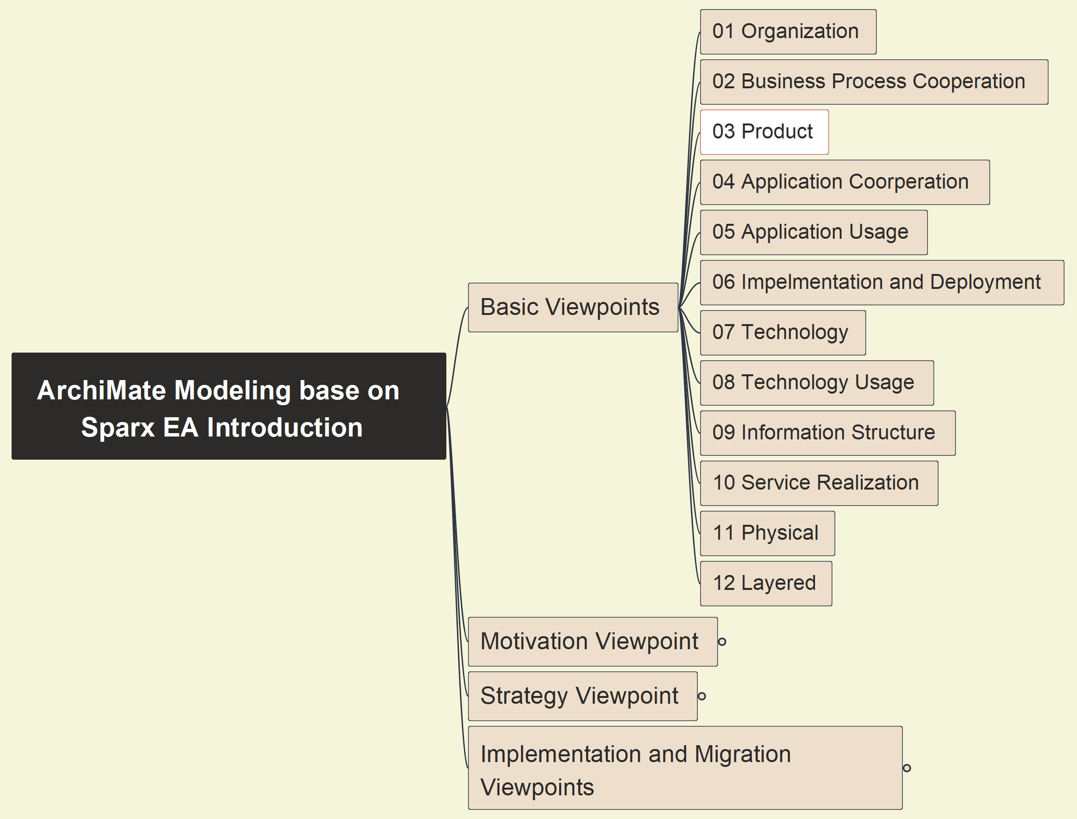
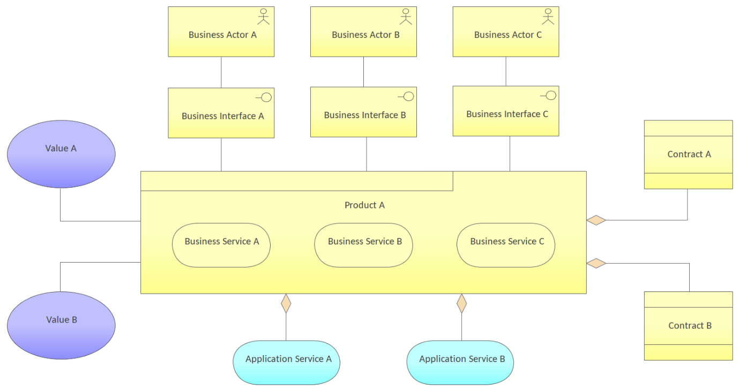
03 Product - Pattern
05

Slide 7
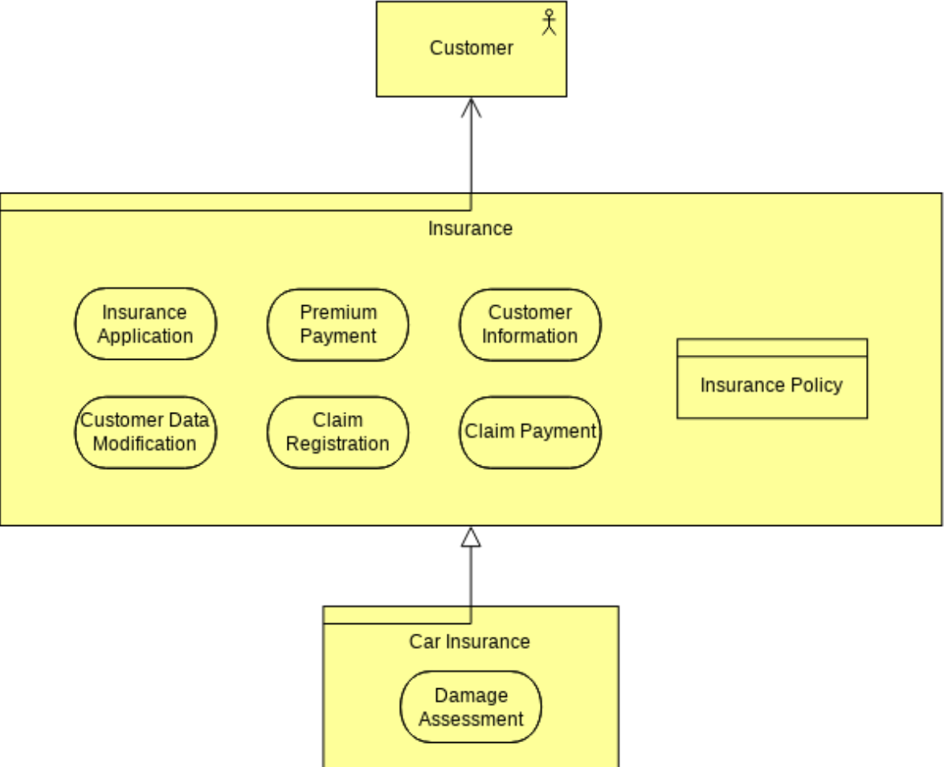
03 Product - Example
06

Slide 8
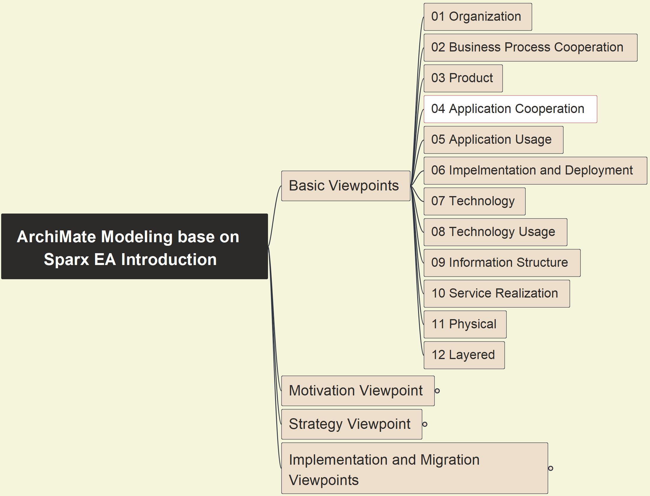
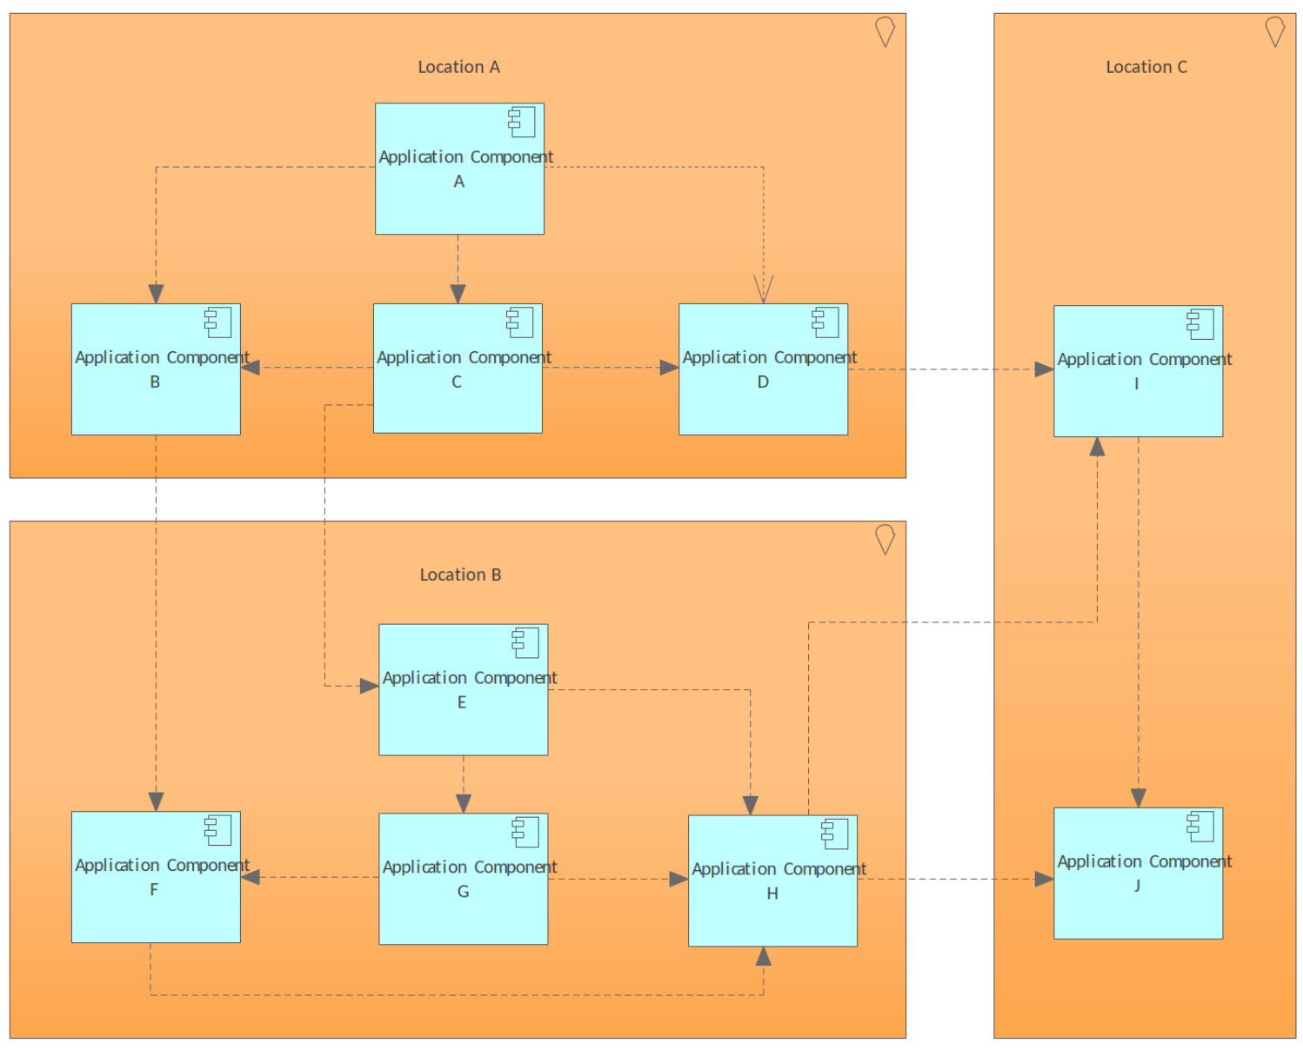
04 Application Cooperation - Pattern
07

Slide 9
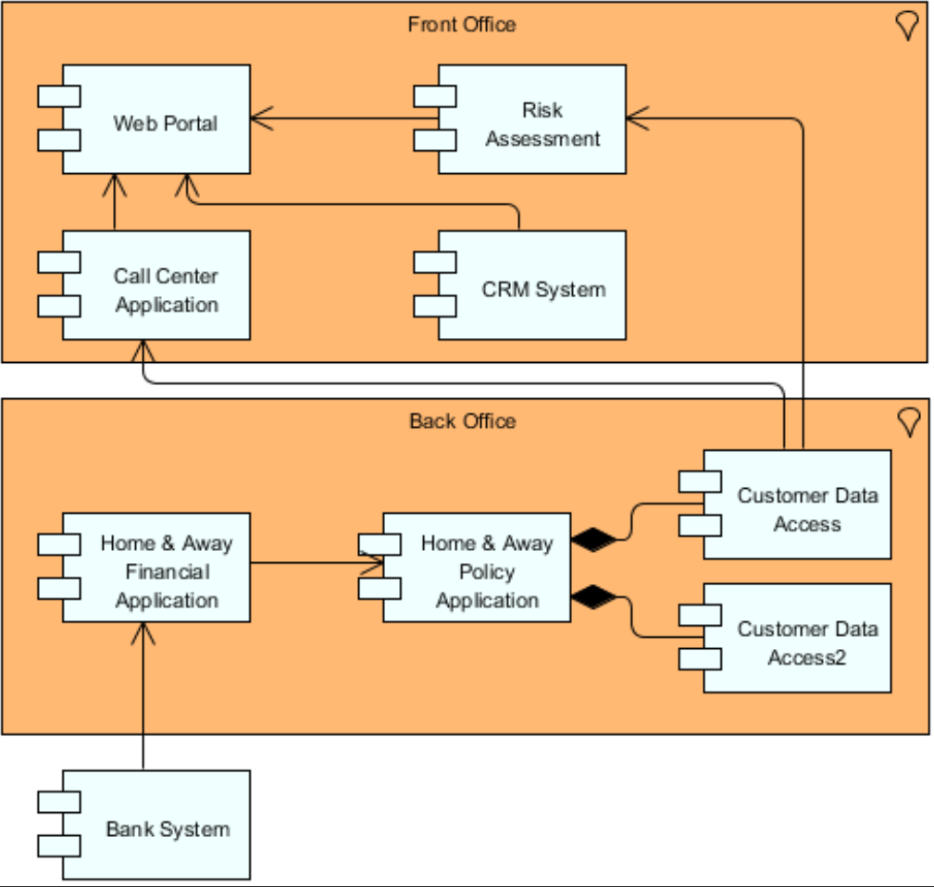
04 Application Cooperation - Example
08

Slide 10
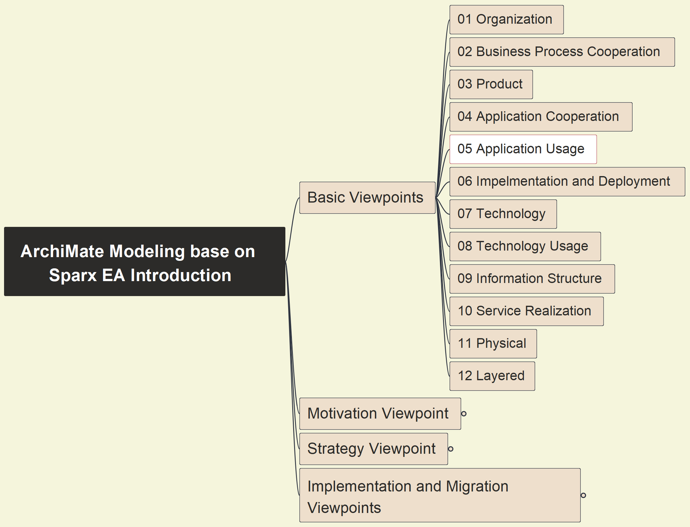
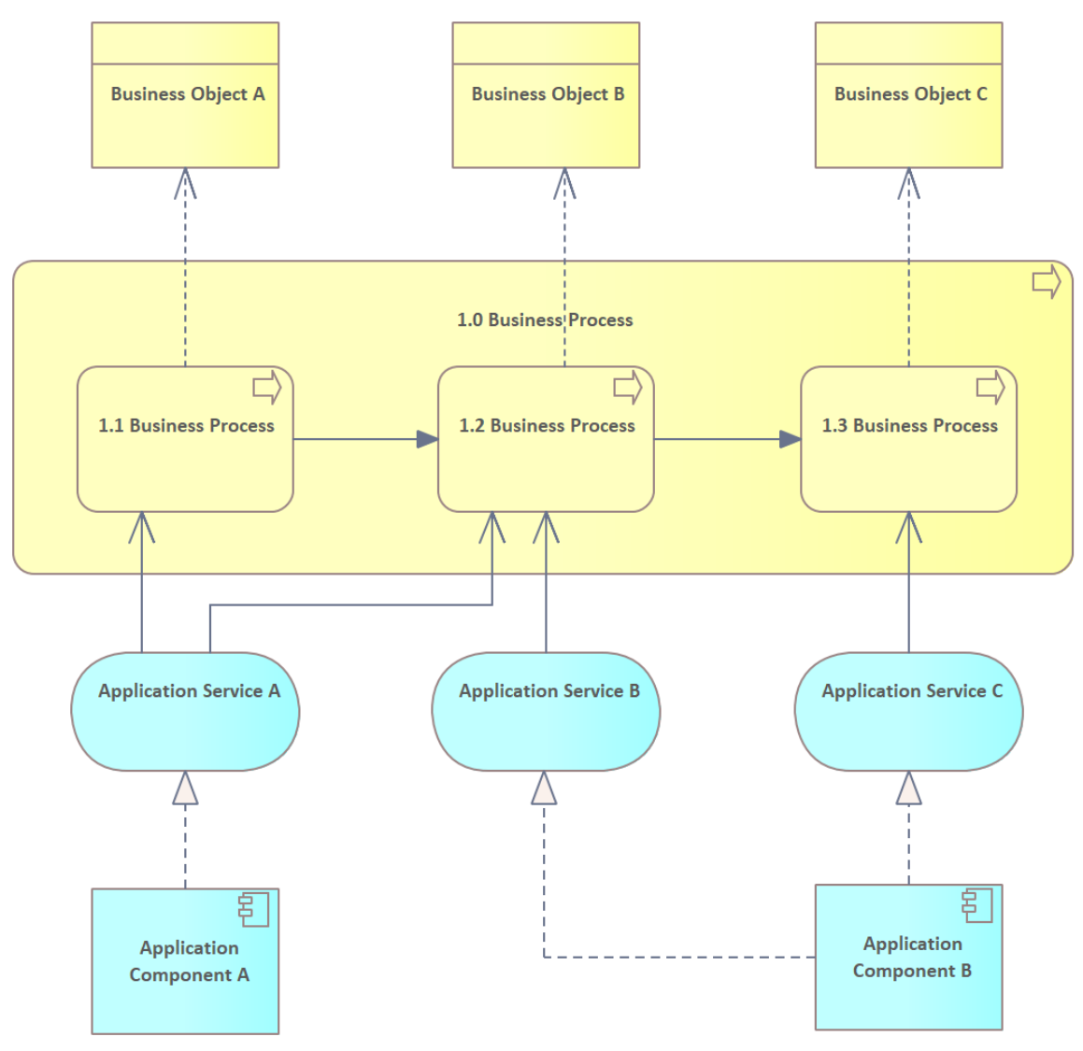
05 Application Usage - Pattern
09

Slide 11
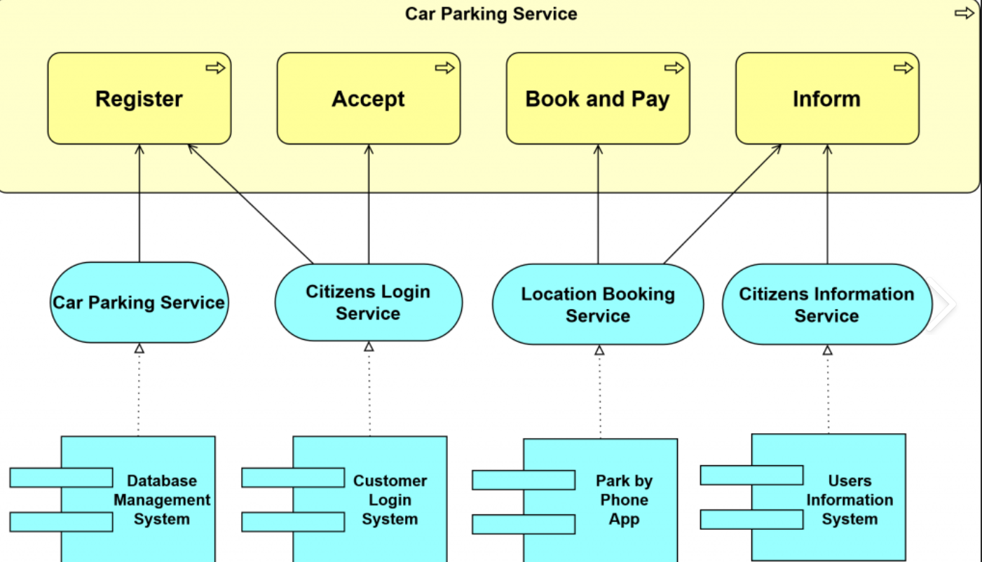
05 Application Usage - Example
10

Slide 12
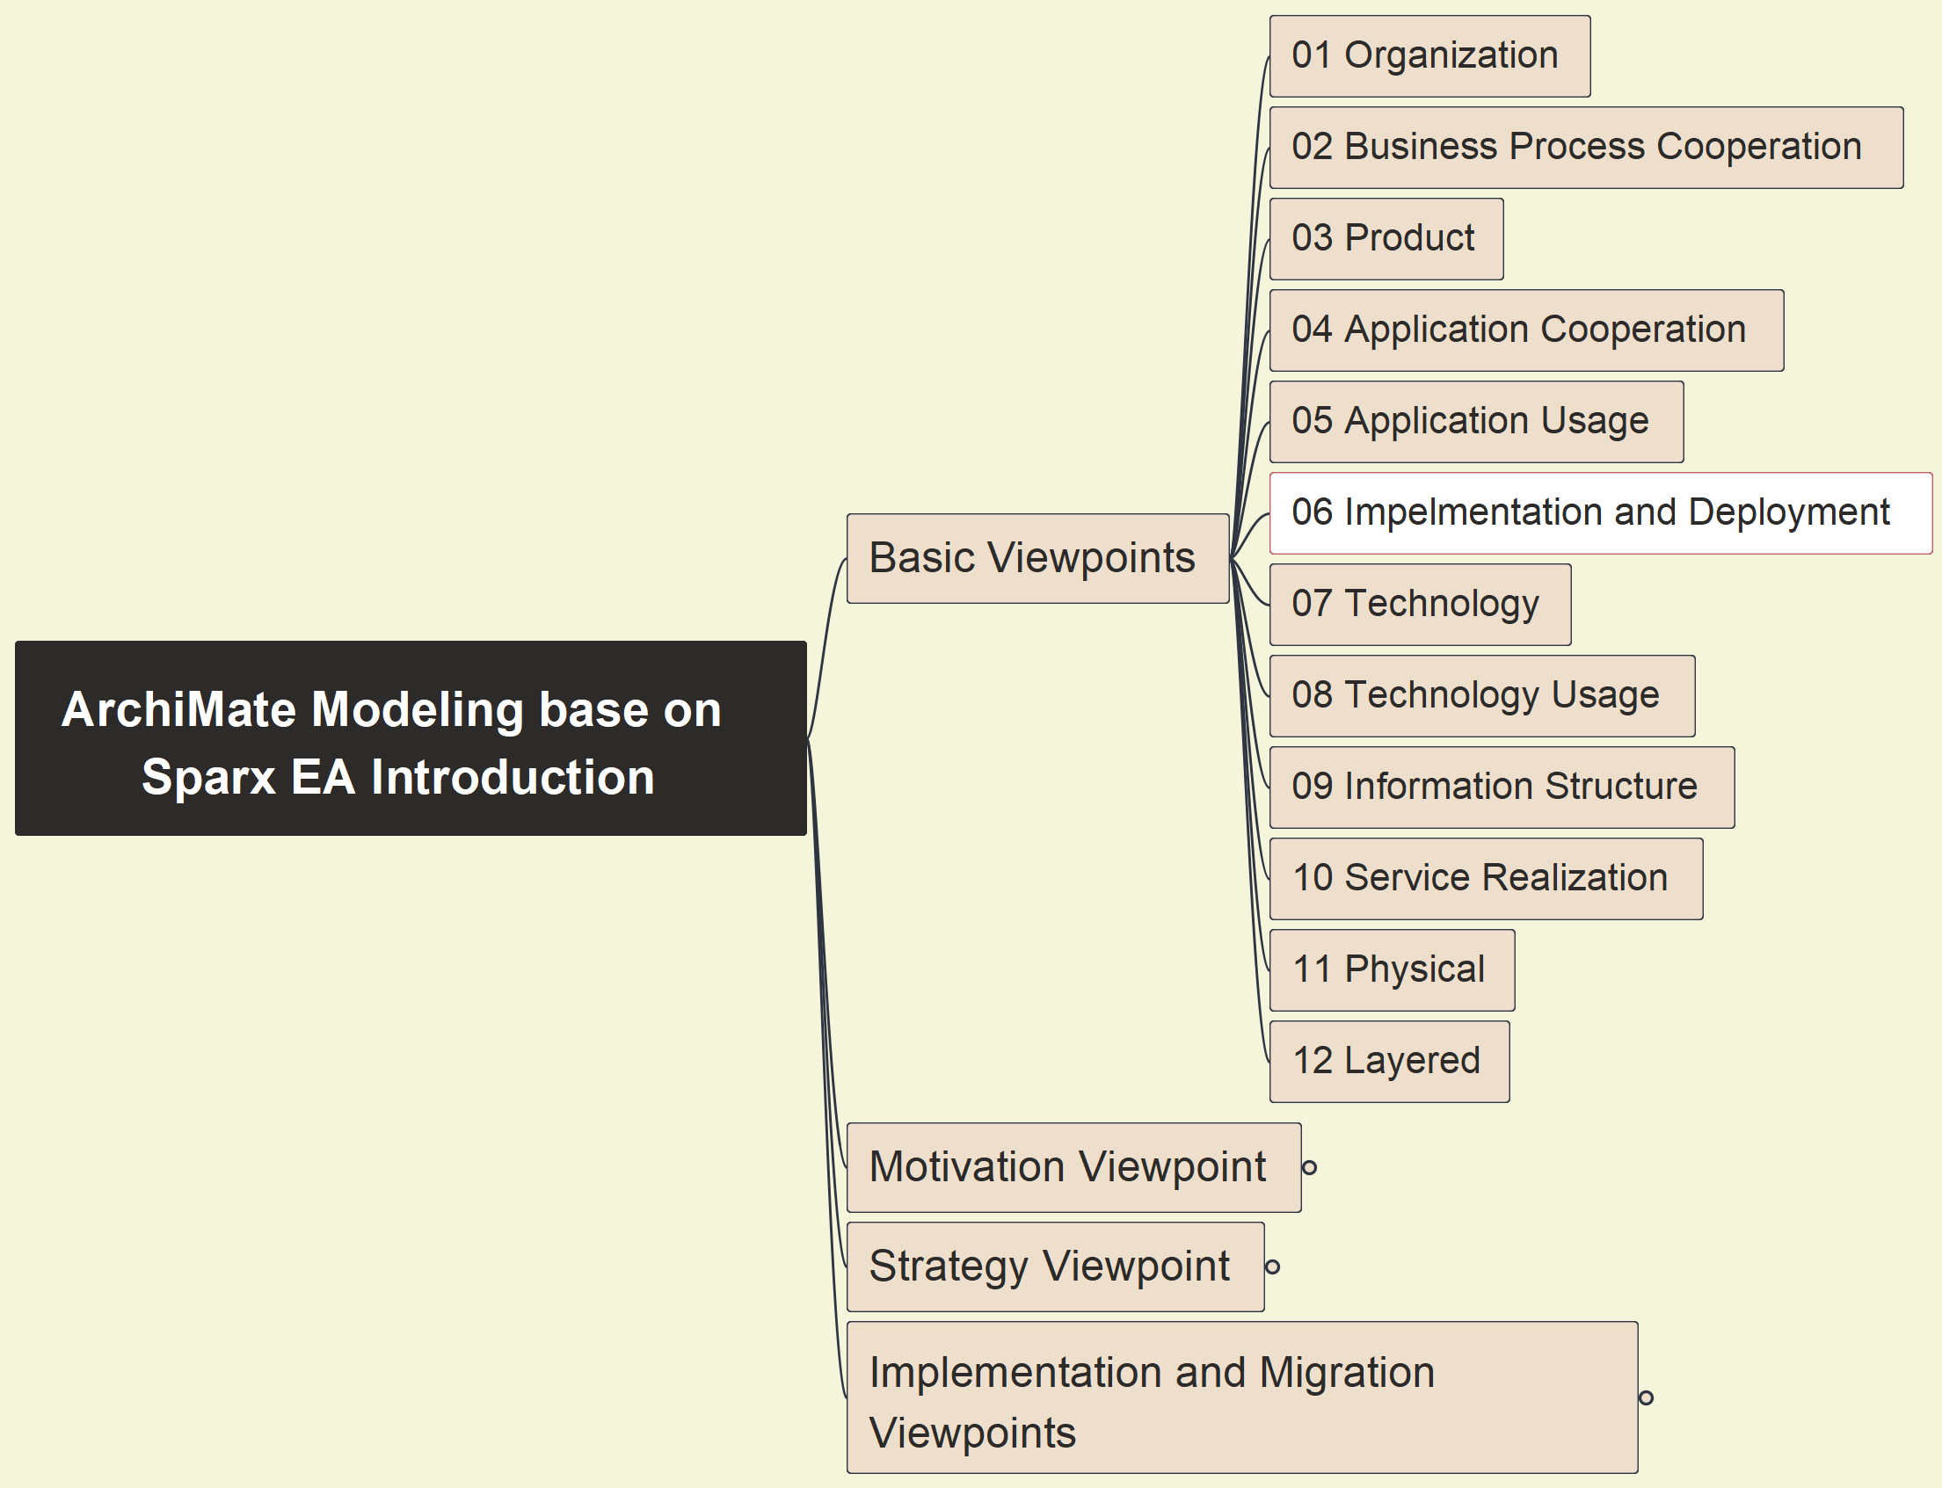
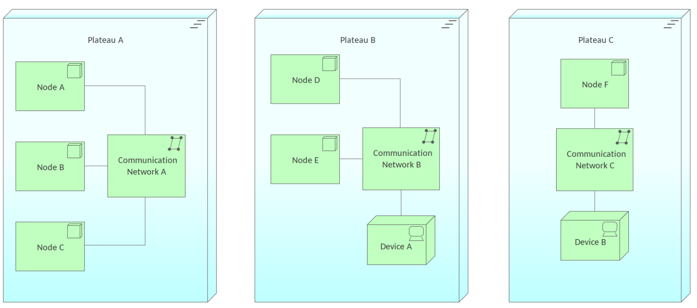
06 Imple. & Deploy. - Pattern
11

Slide 13
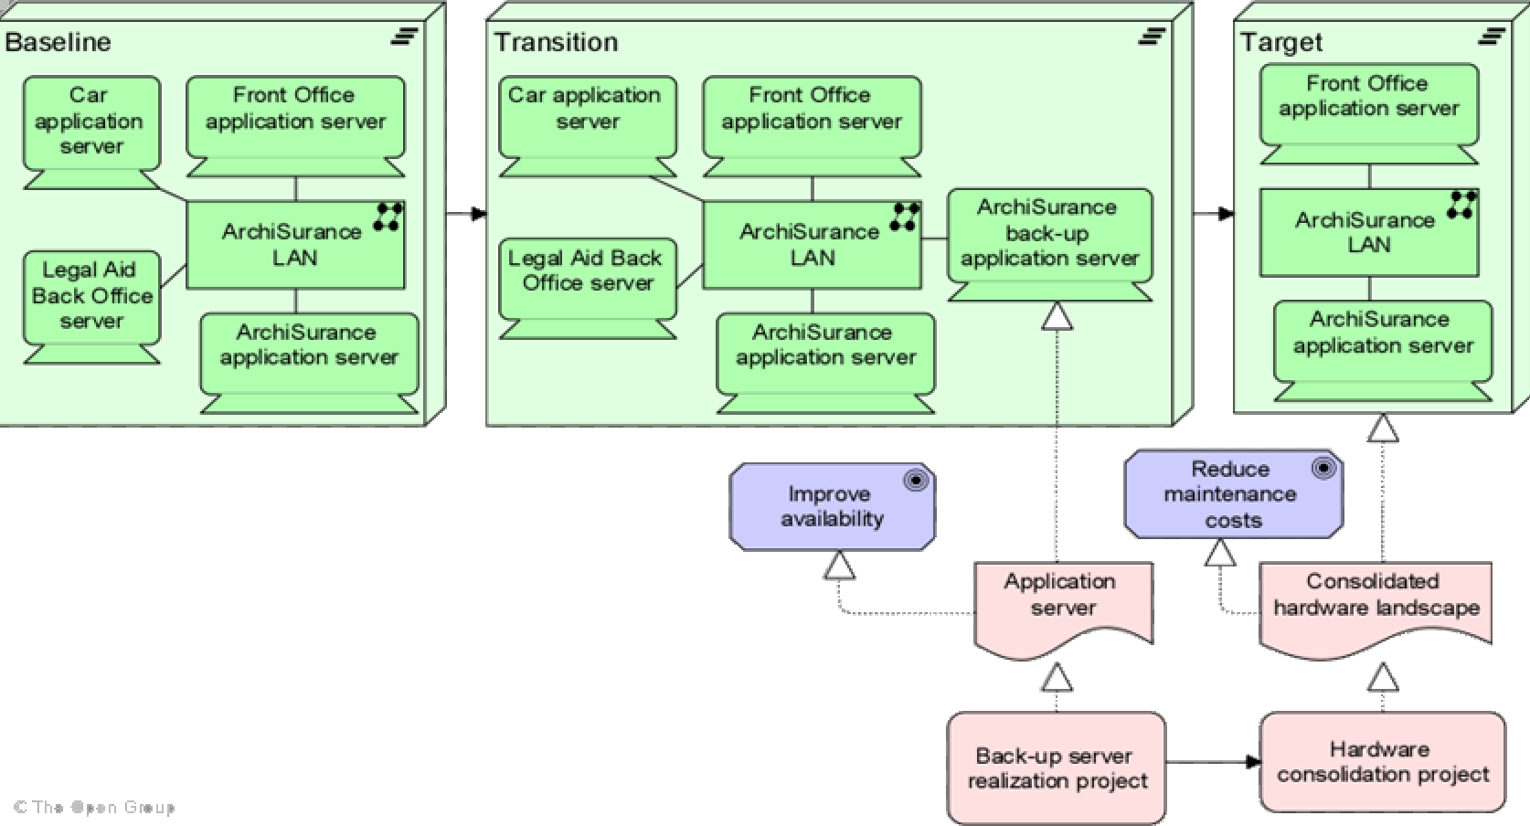
06 Imple. & Deploy. - Example
12

Slide 14
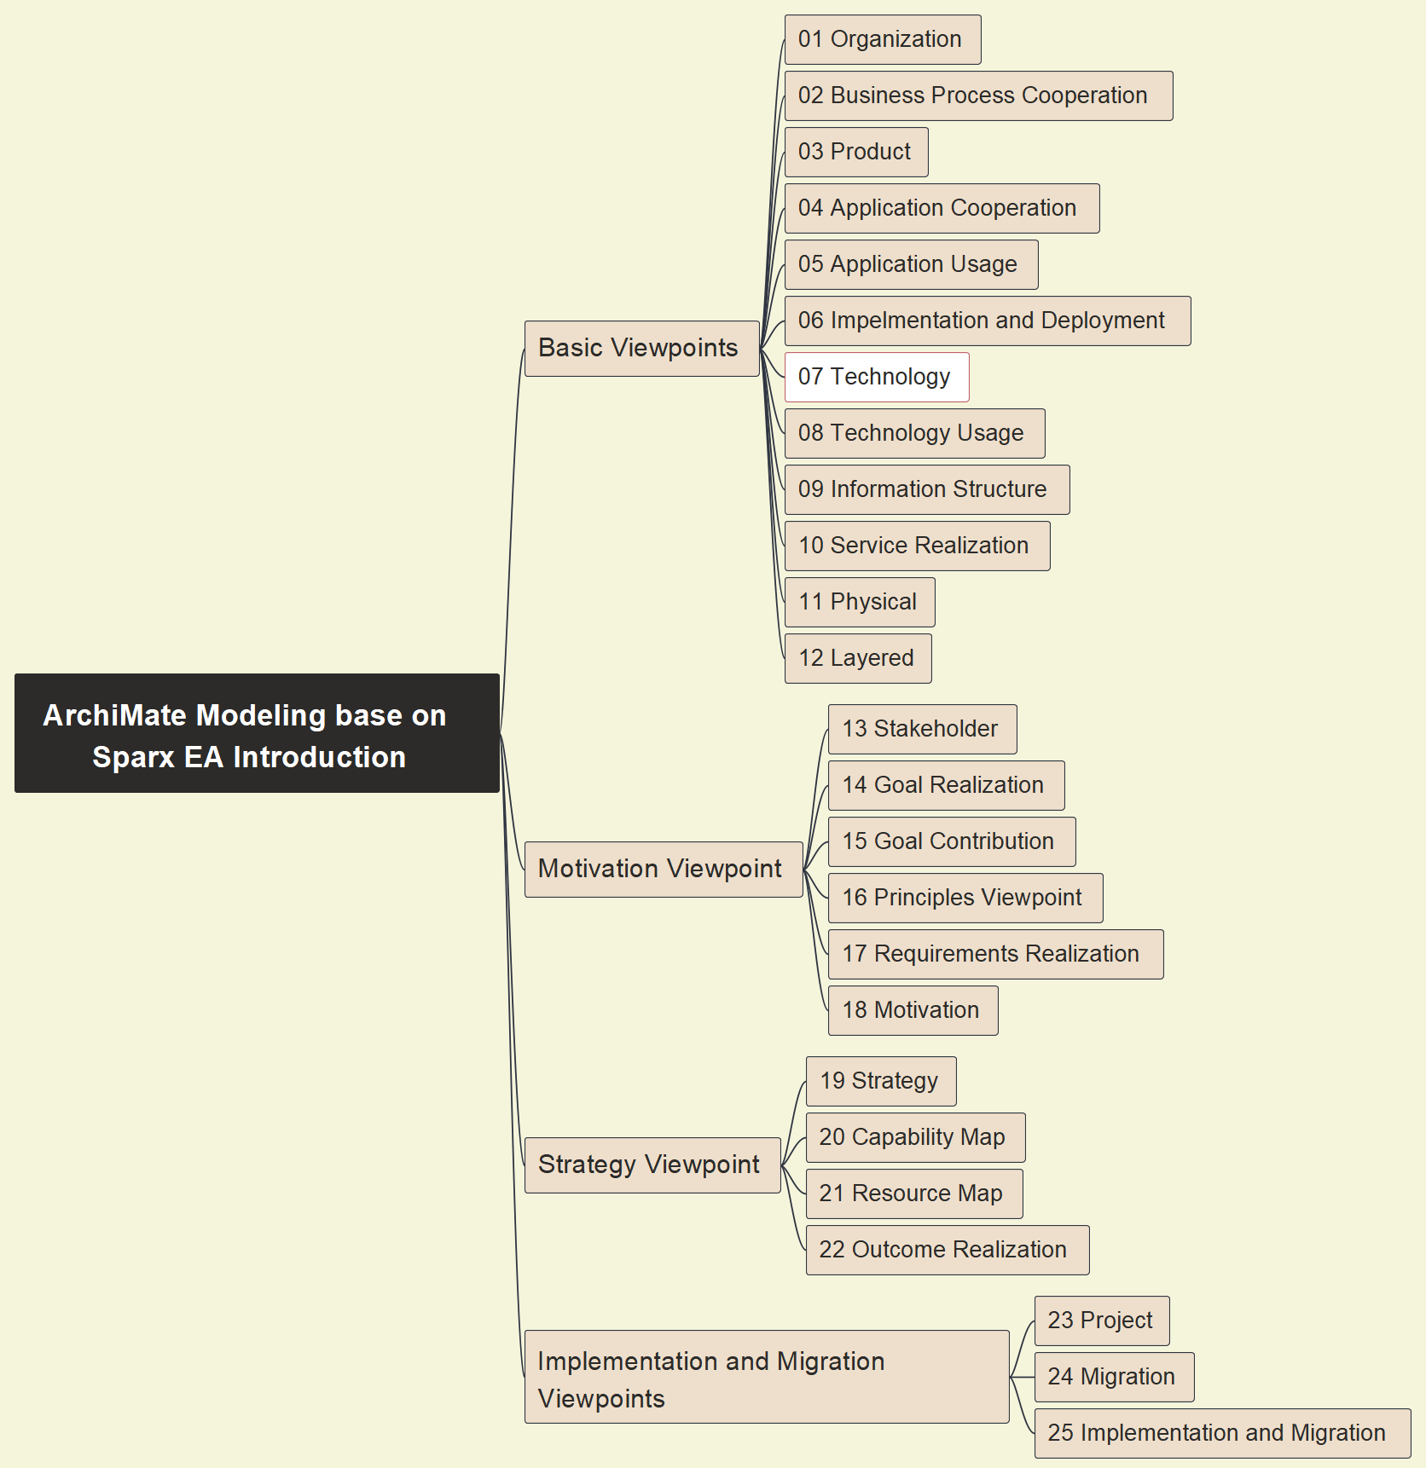
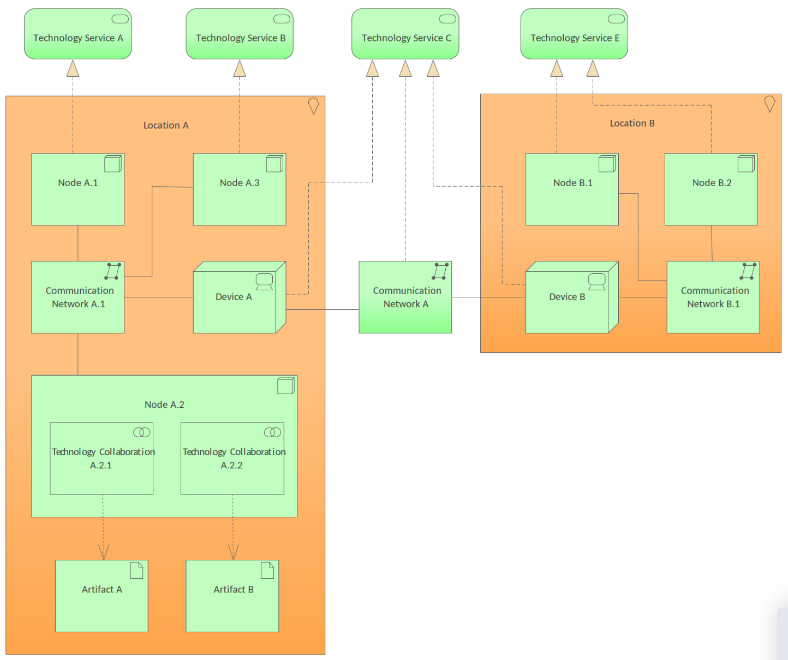
07 Technology - Pattern
13

Slide 15
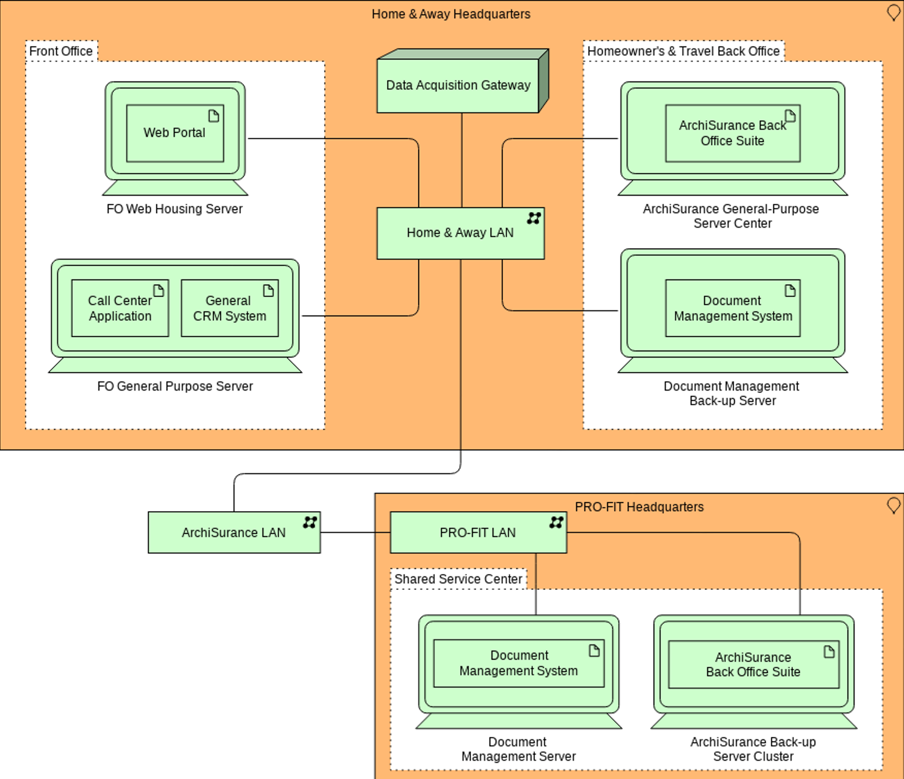
07 Technology - Example
14

Slide 16
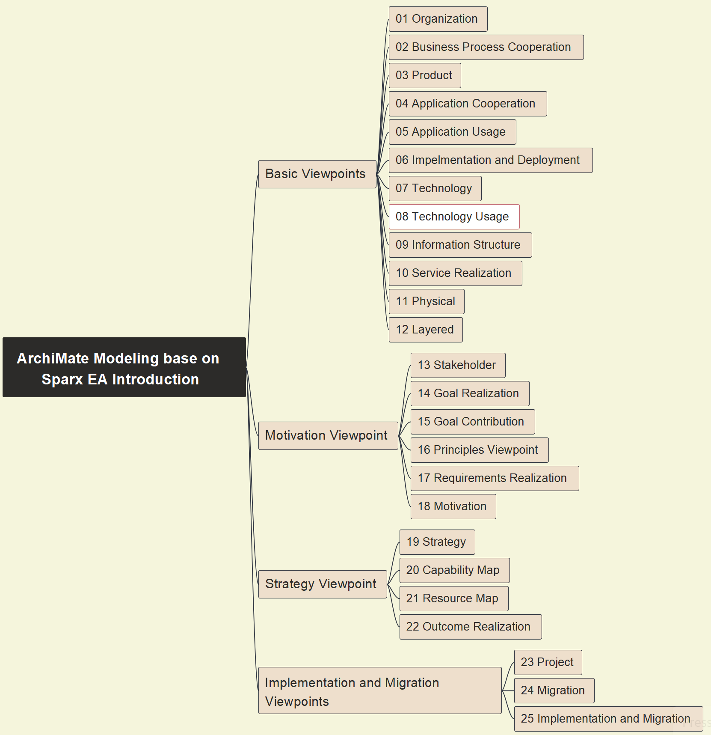
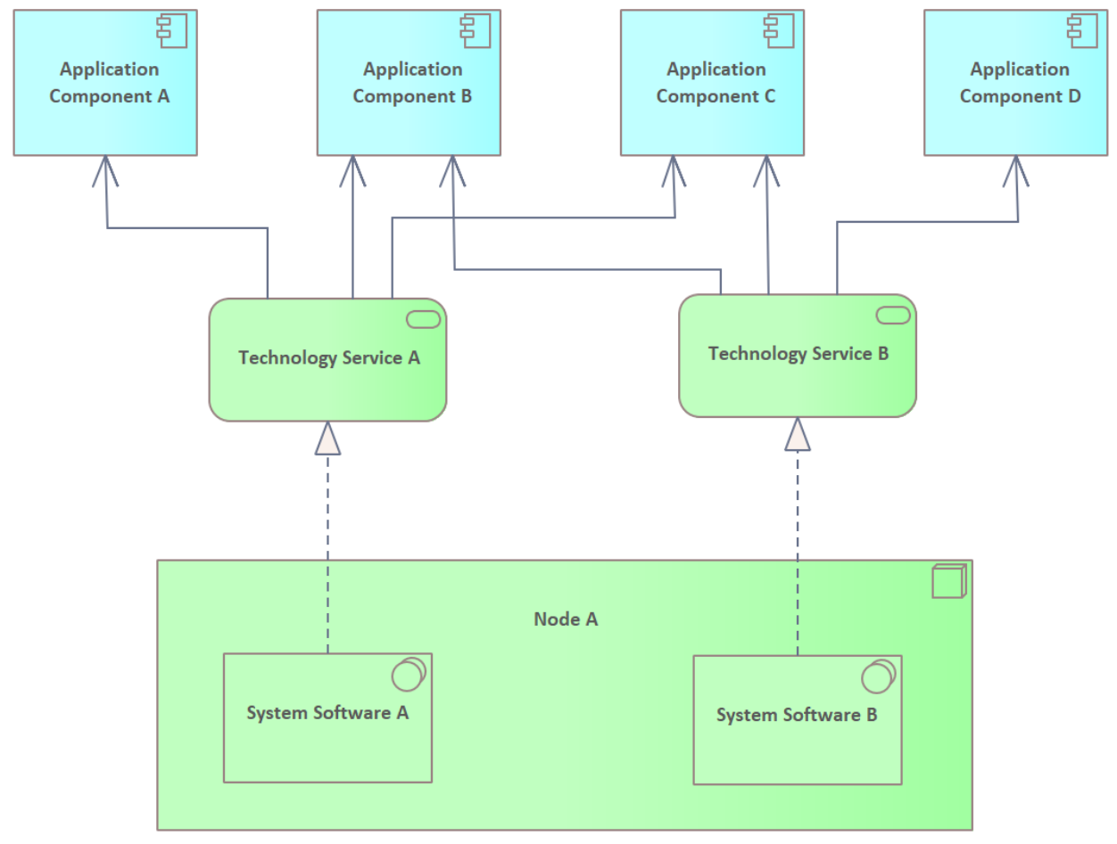
08 Technology Usage - Pattern
15

Slide 17
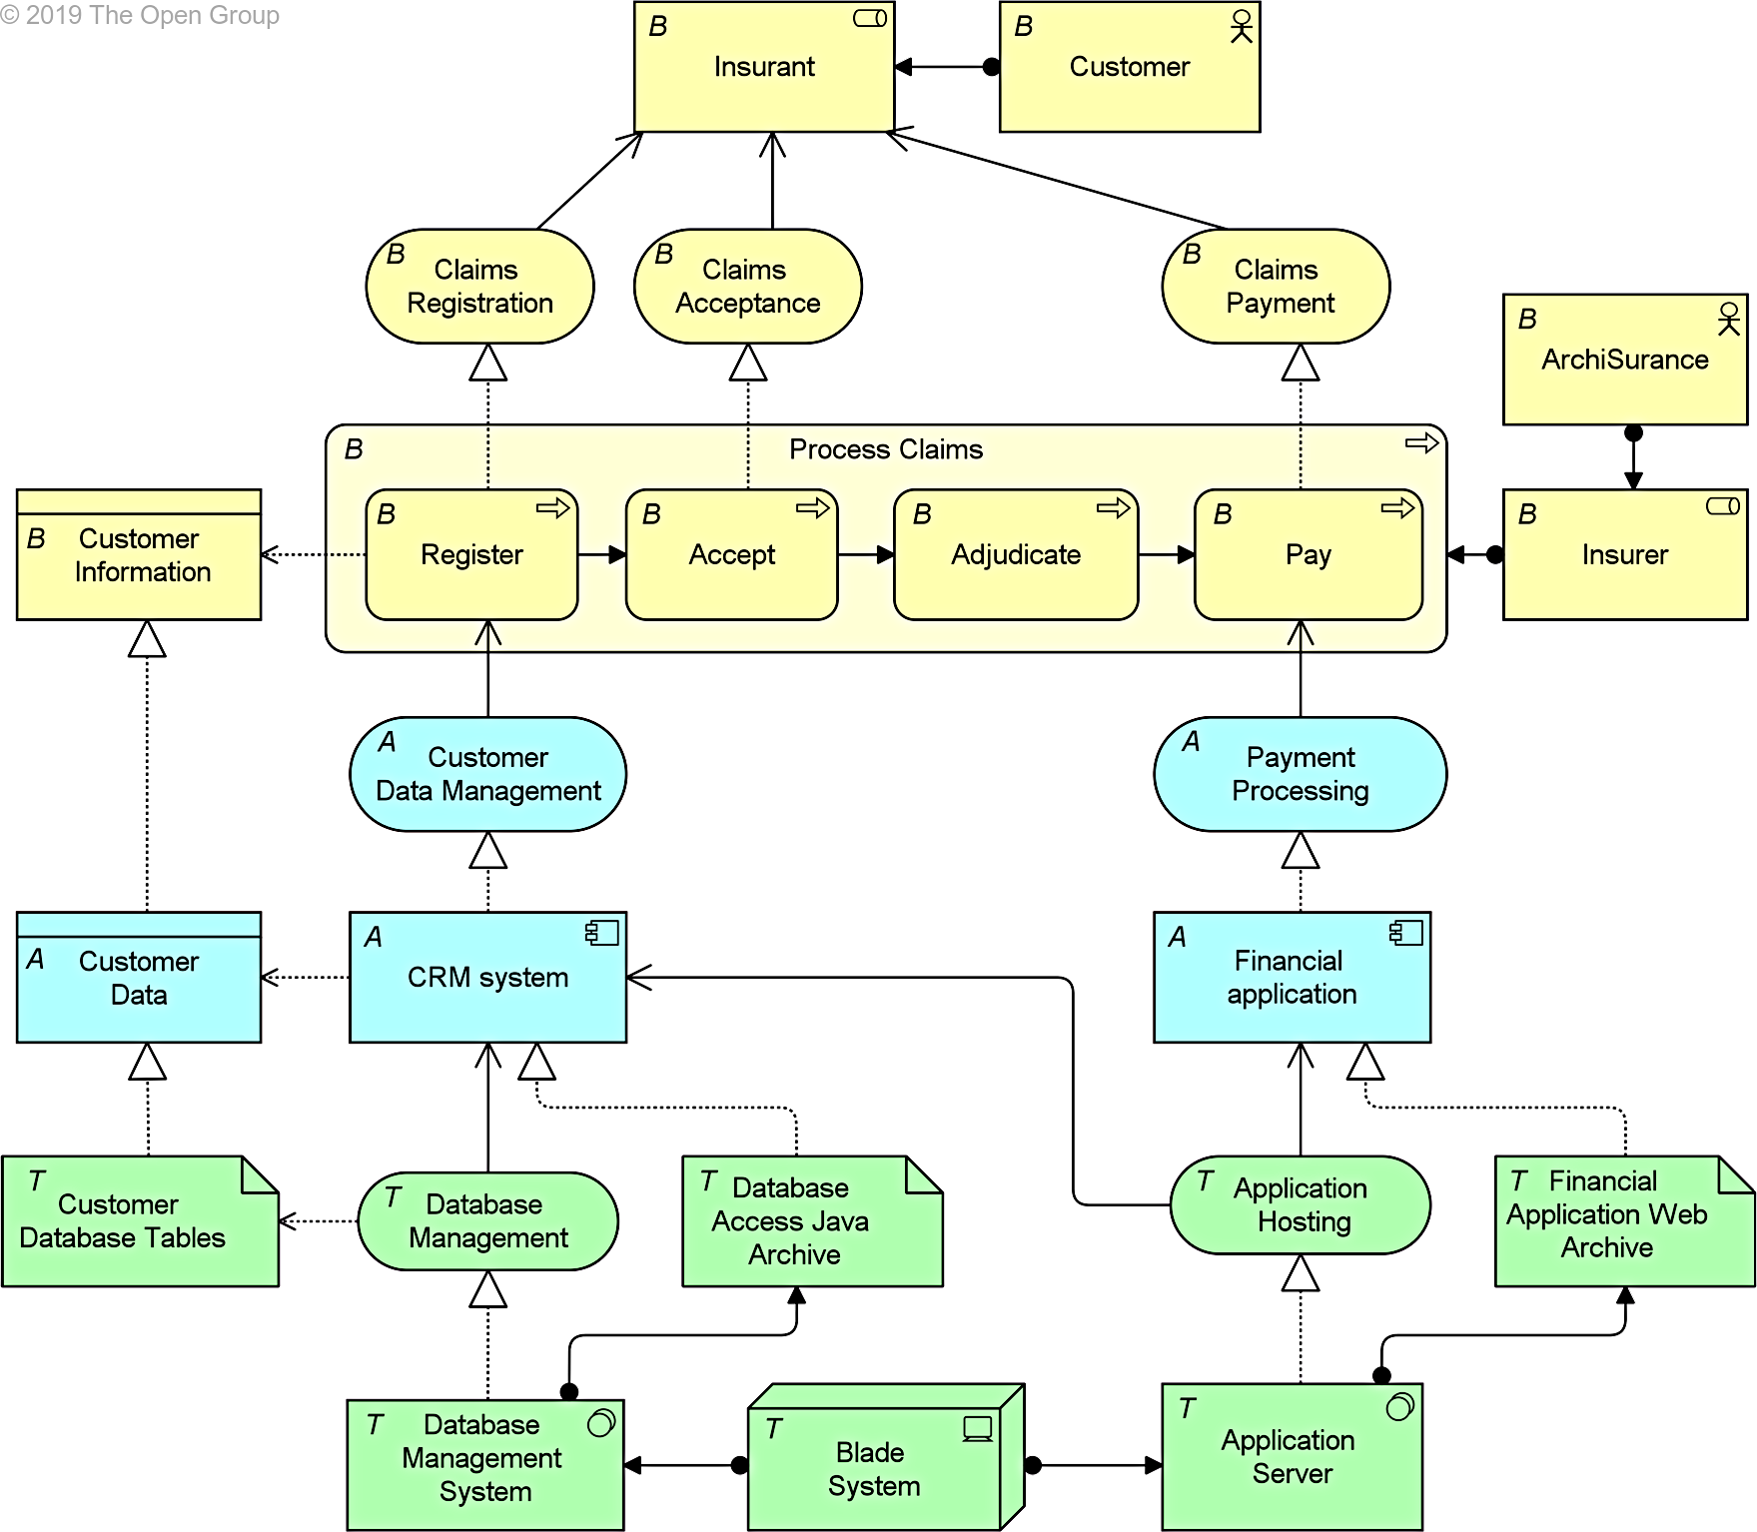
08 Technology Usage - Example
16

Slide 18

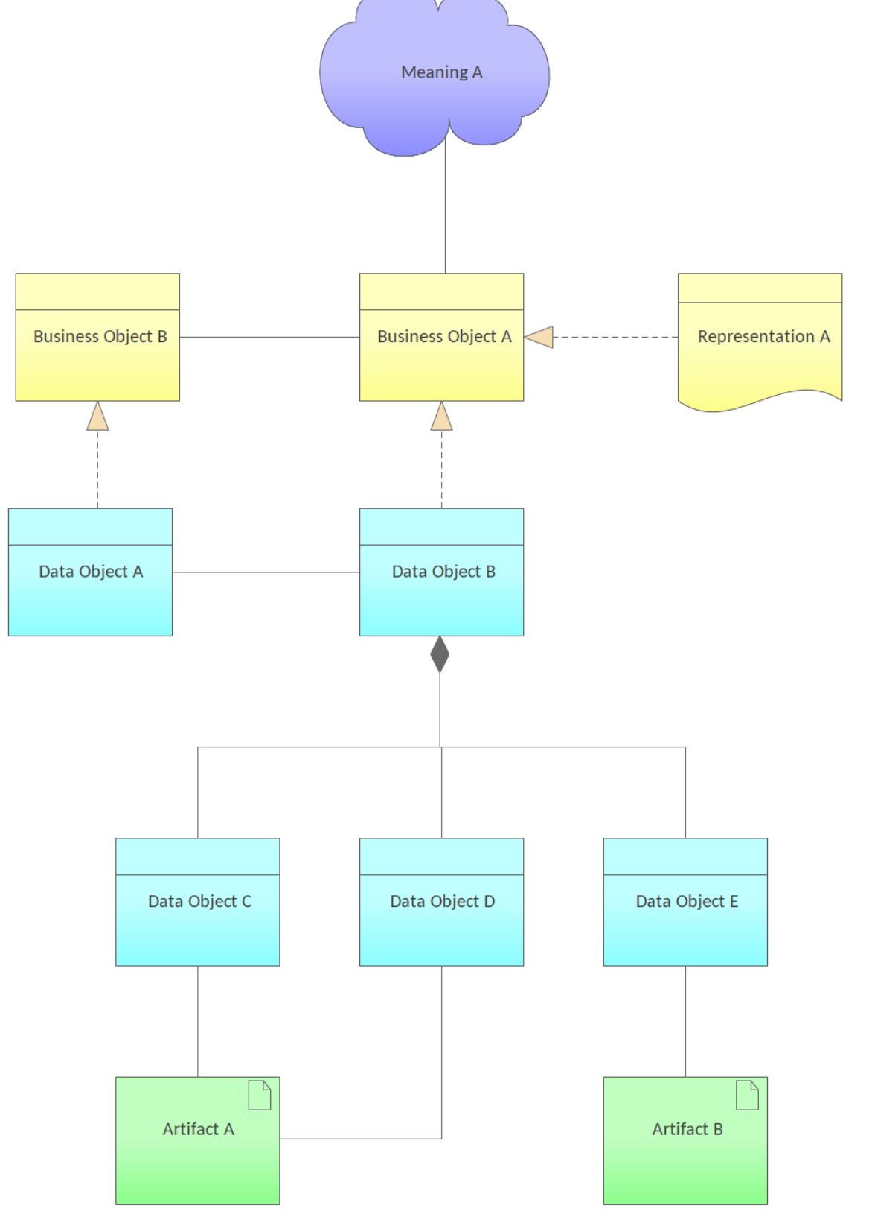
09 Information Structure - Pattern
17

Slide 19
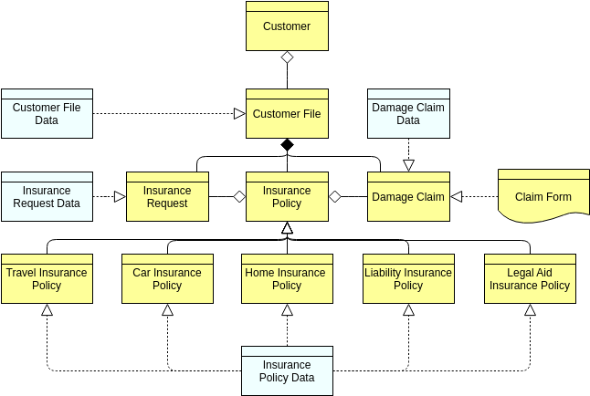
09 Information Structure - Example
18

Slide 20
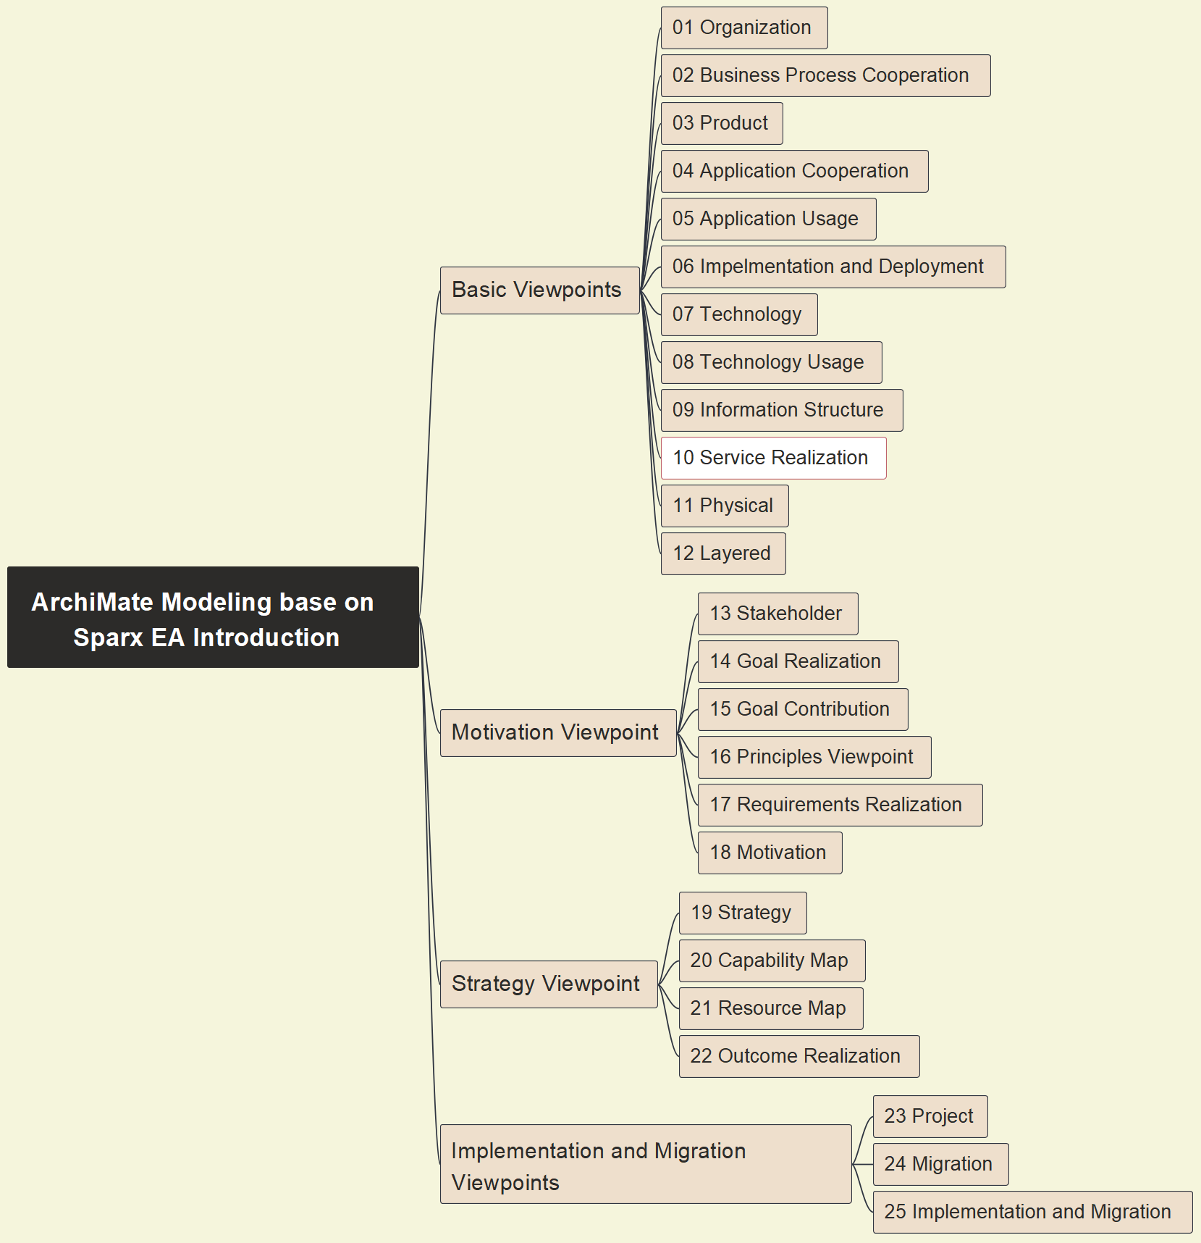
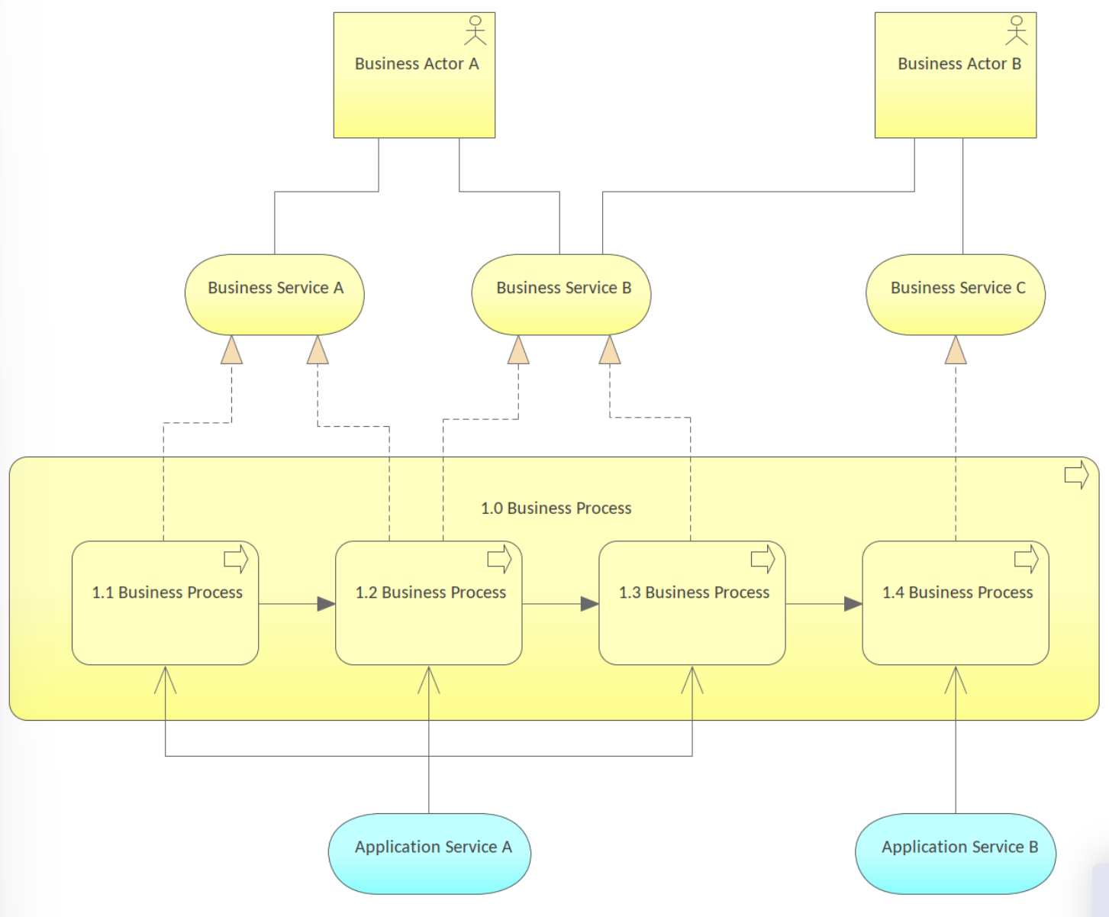
10 Service Realization - Pattern
19

Slide 21
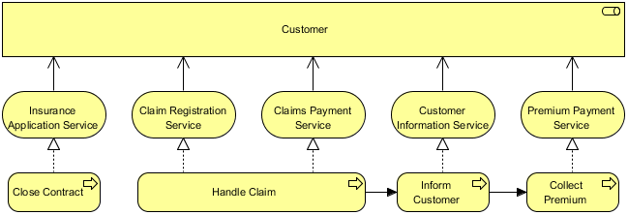
10 Service Realization - Example
20

Slide 22
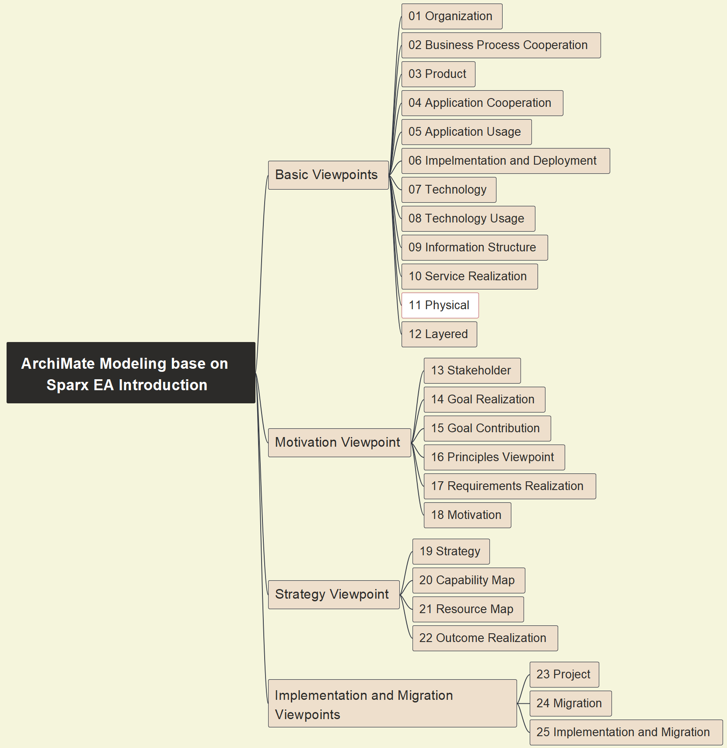
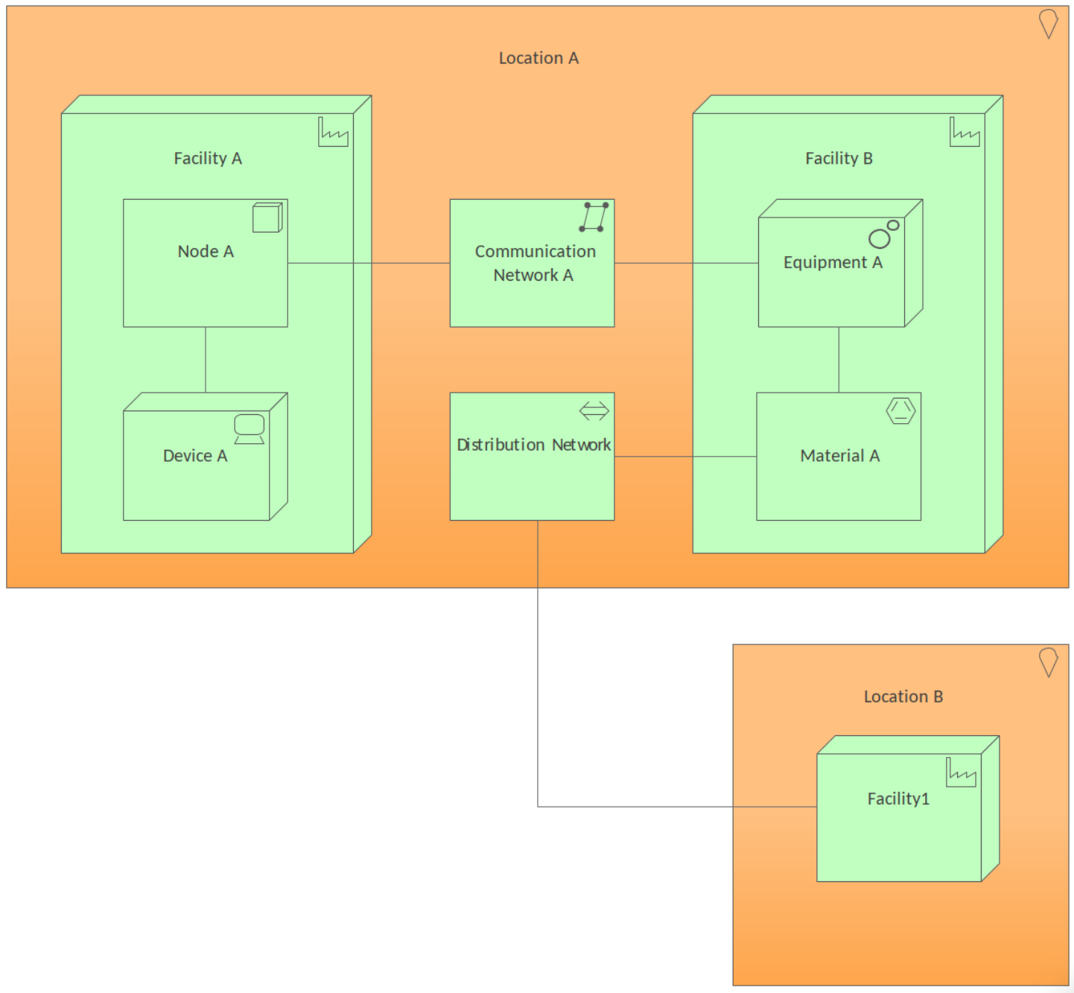
11 Physical - Pattern
21

Slide 23
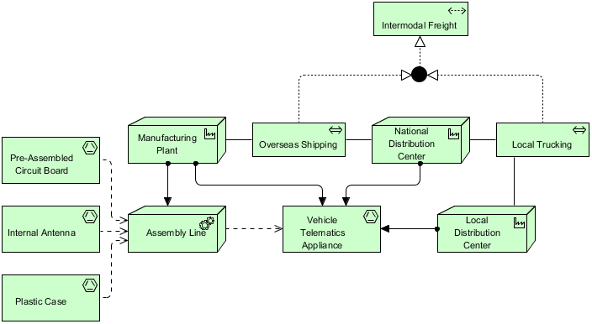
11 Physical - Example
22

Slide 24
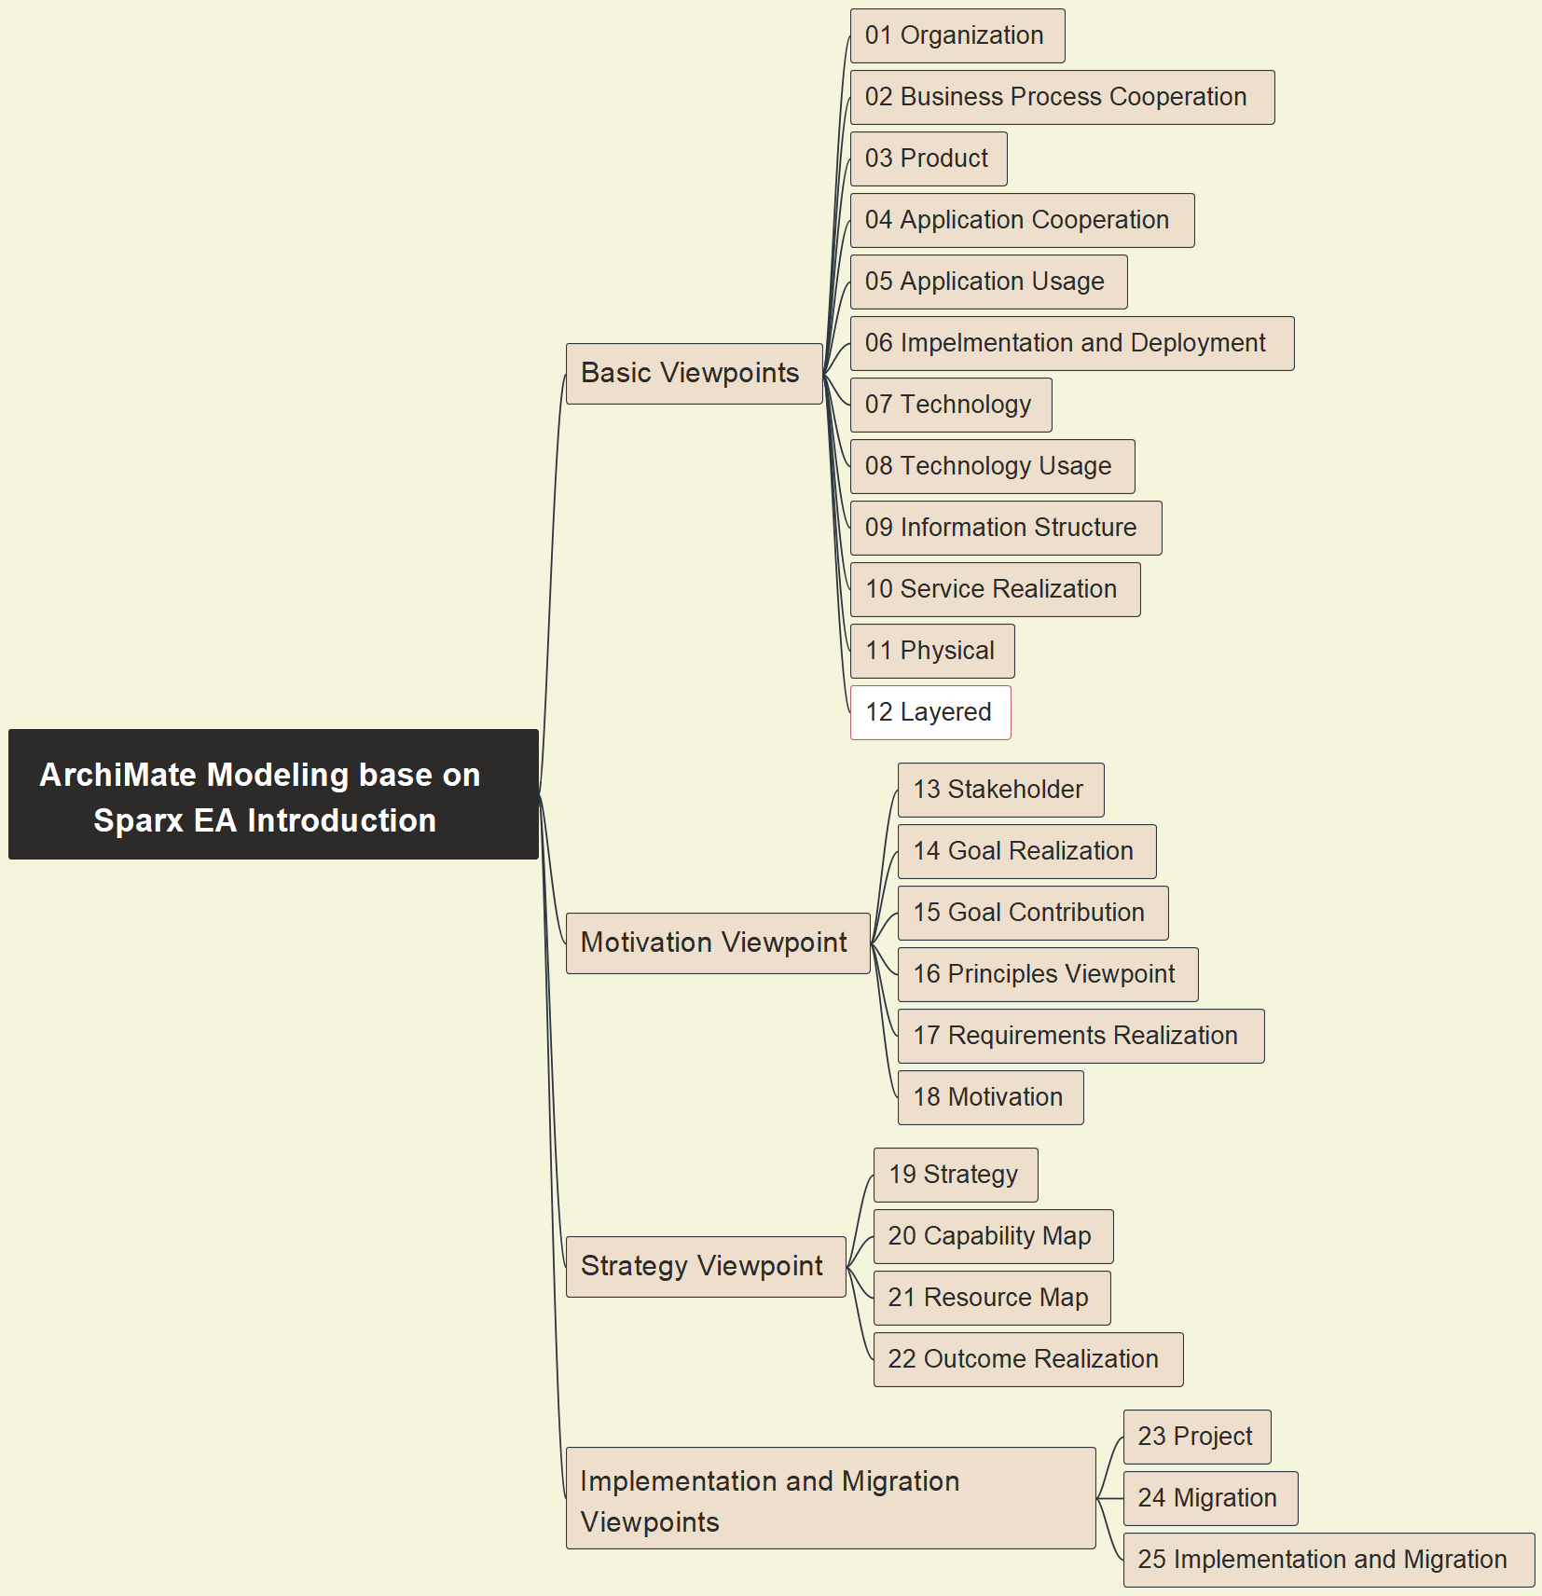
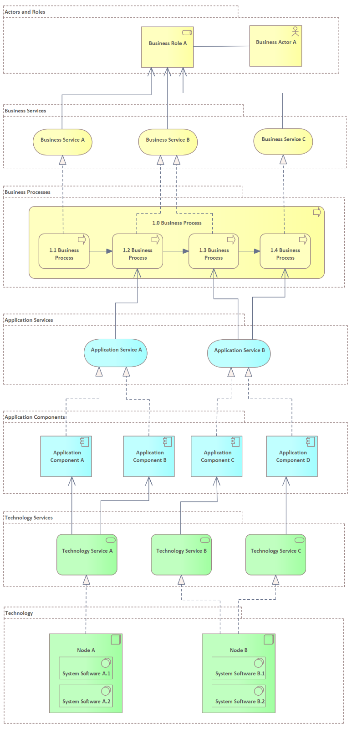
12 Layered - Pattern
23

Slide 25
12 Layered - Example
24

Slide 26
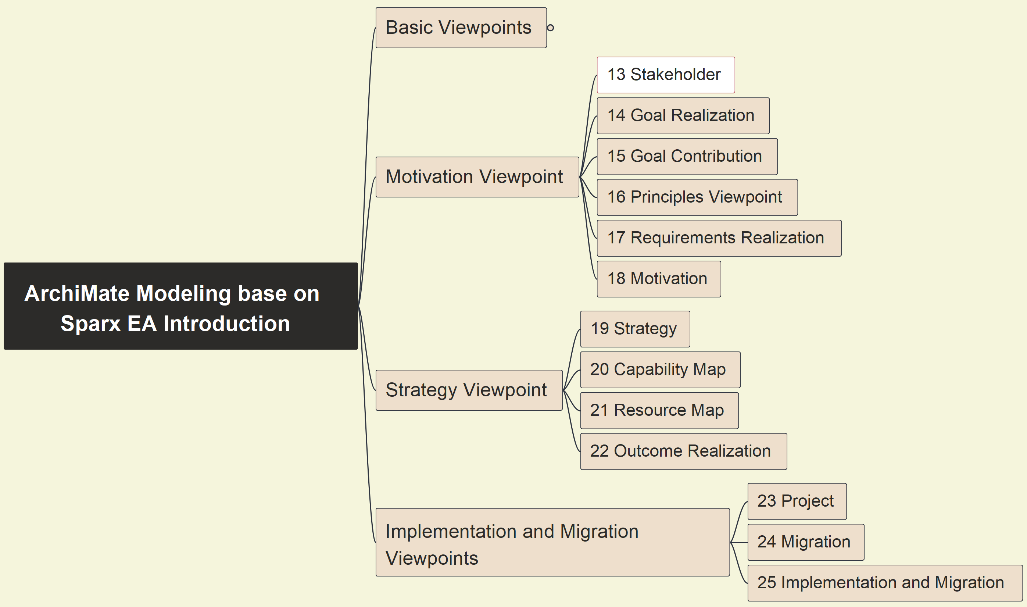
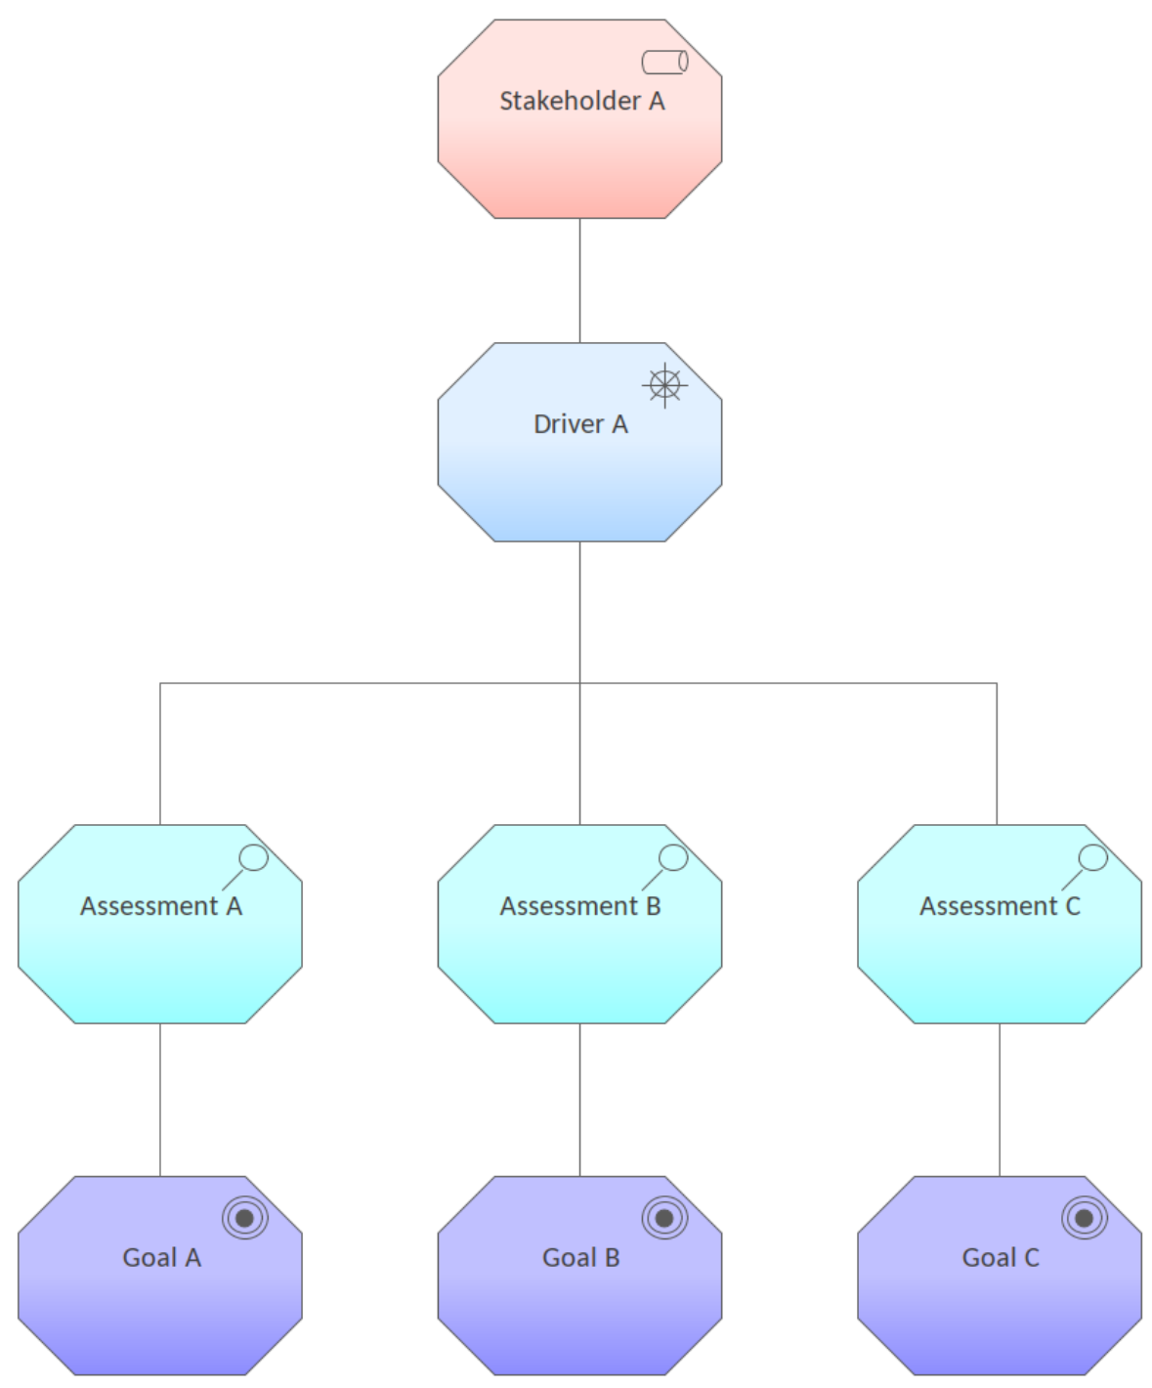
13 Stakeholder - Pattern
25

Slide 27
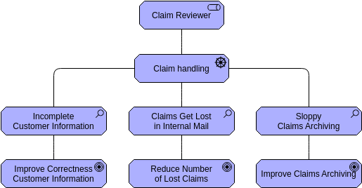
13 Stakeholder - Example
26

Slide 28
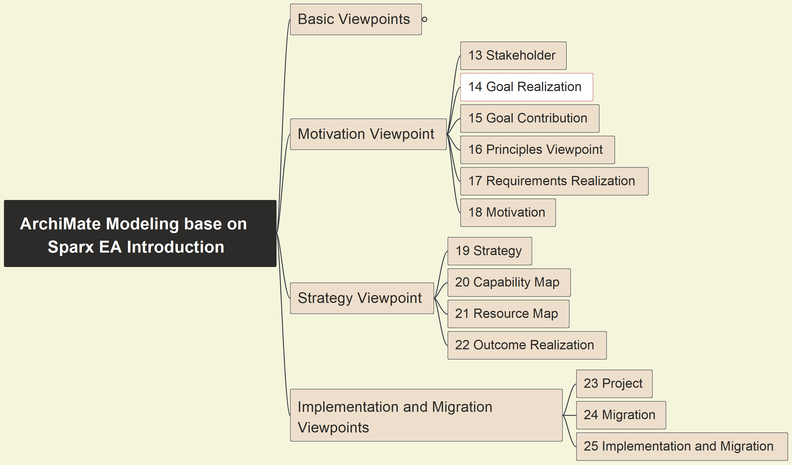
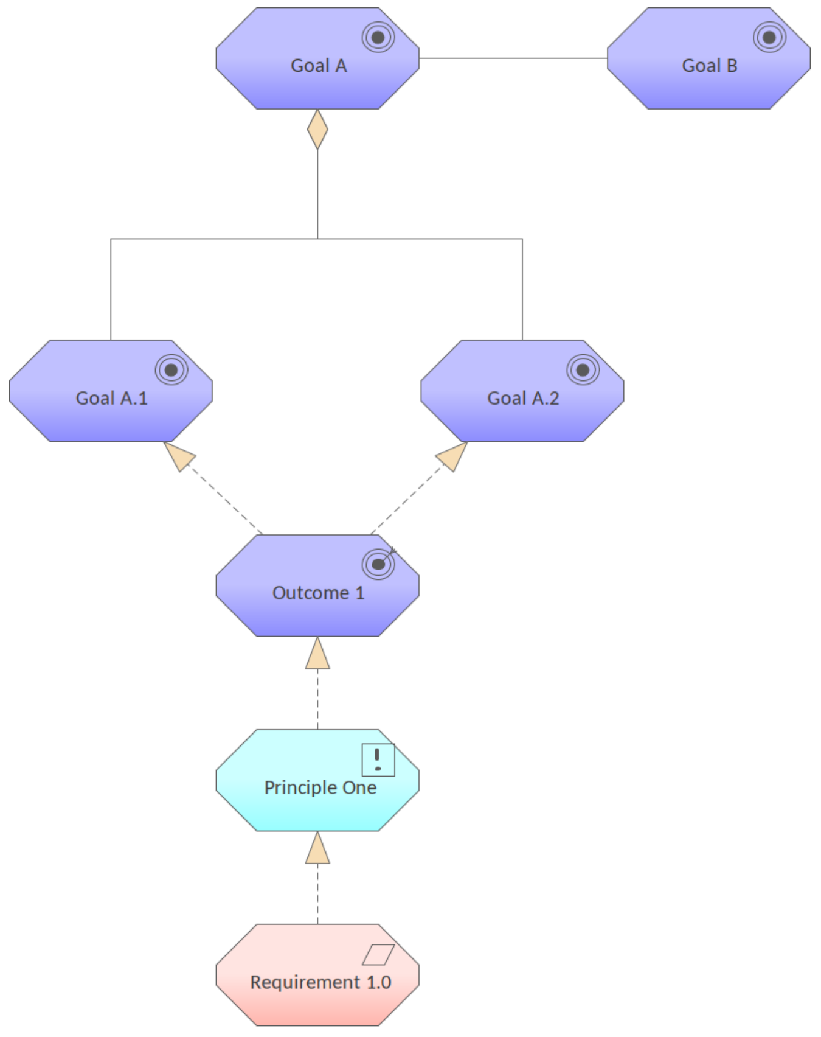
14 Goal Realization - Pattern
27

Slide 29
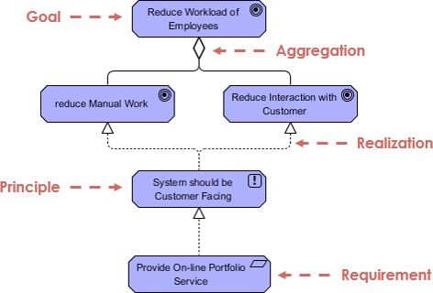
14 Goal Realization - Example
28

Slide 30
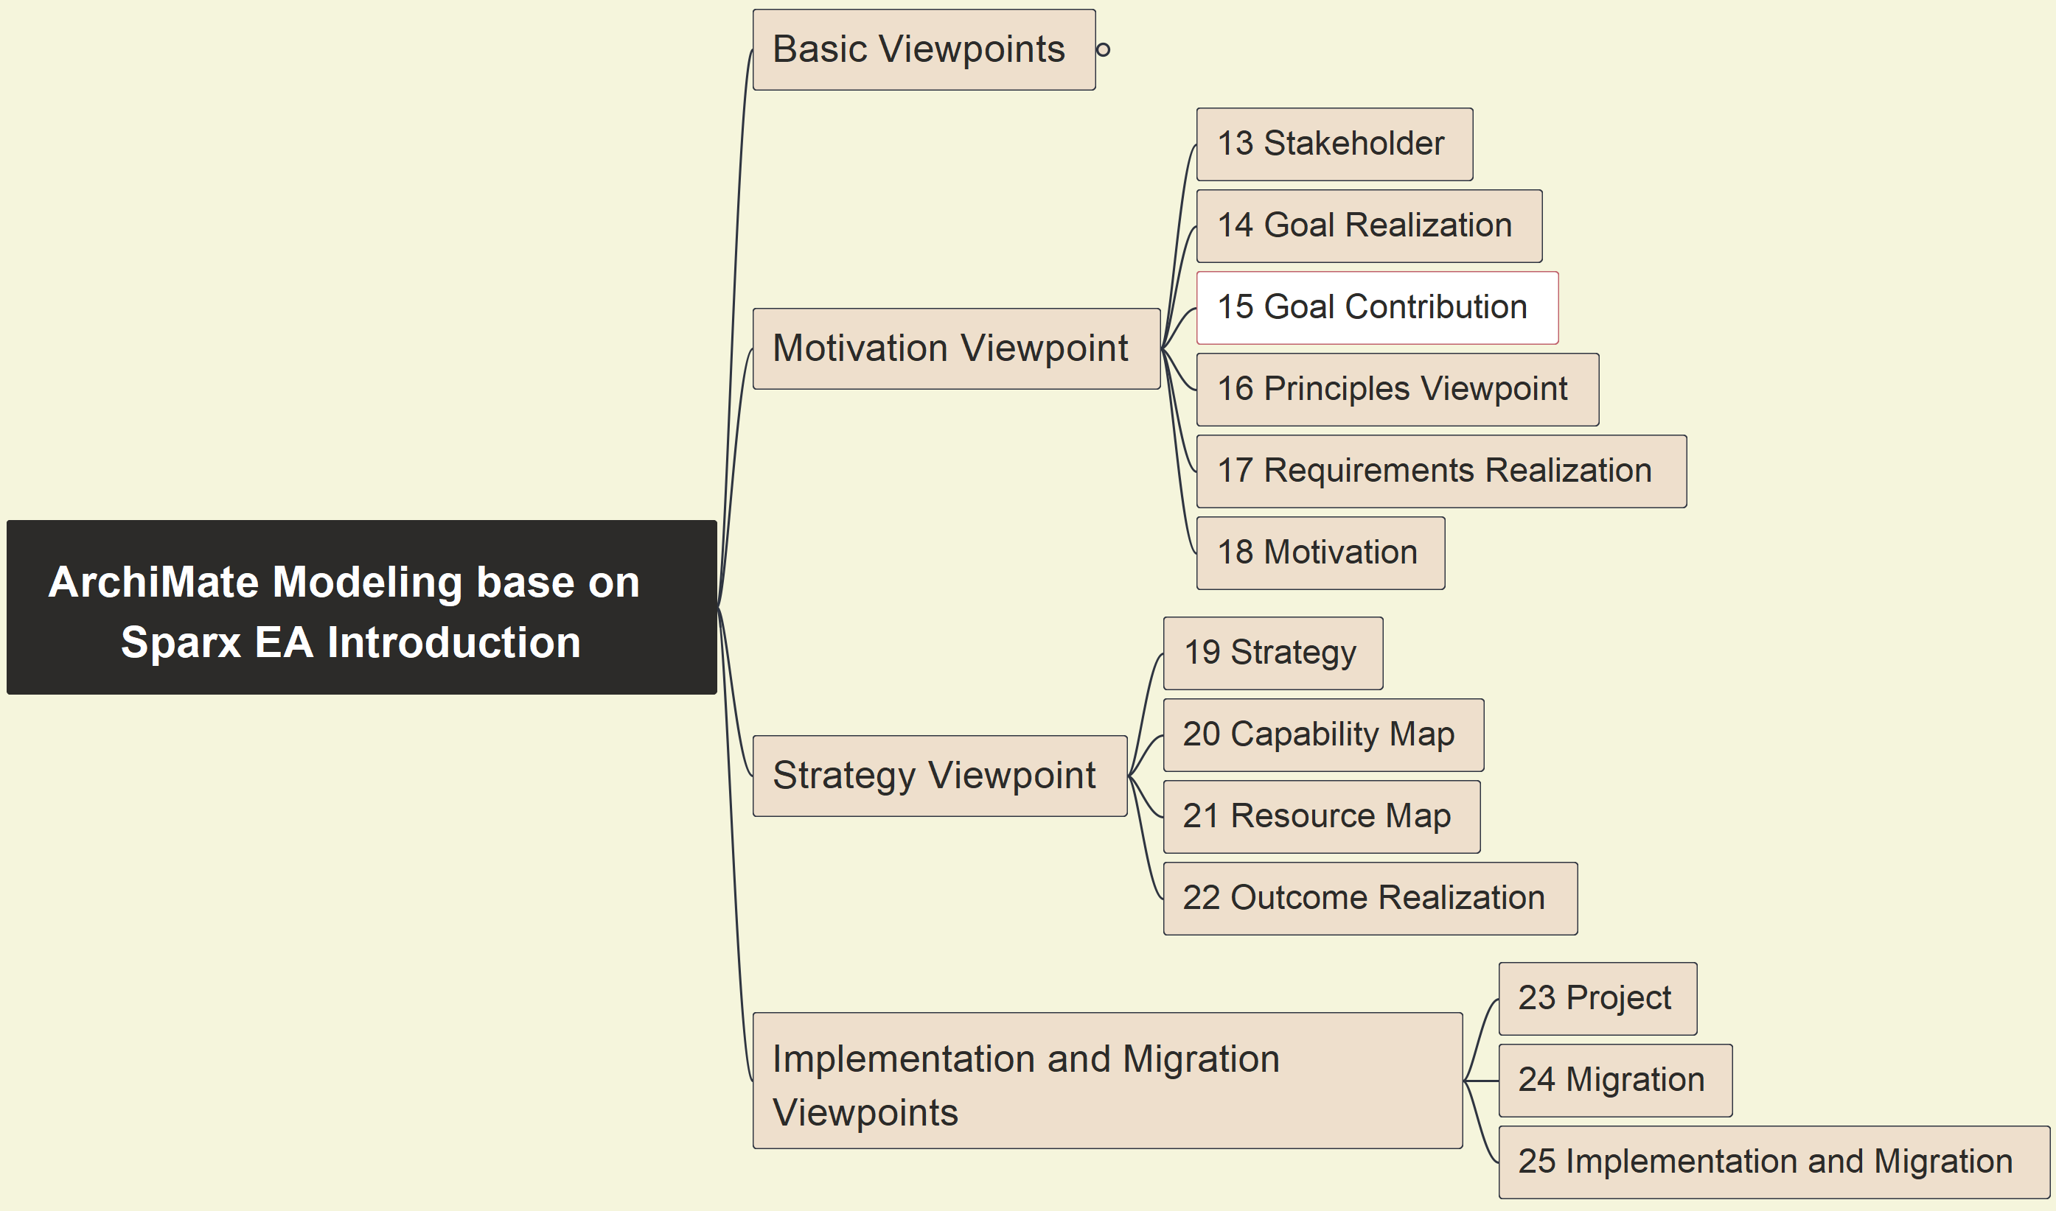
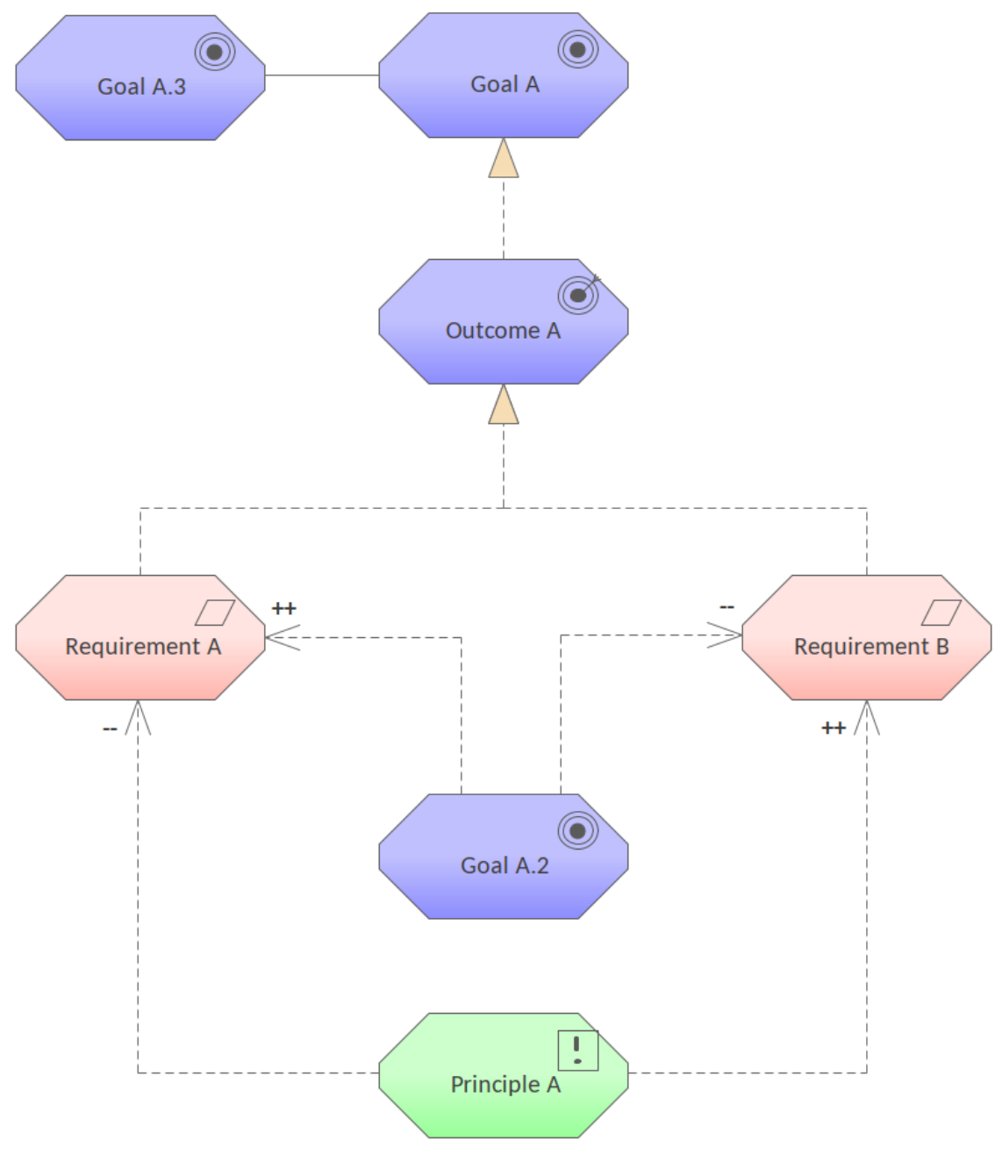
15 Goal Contribution - Pattern
29

Slide 31
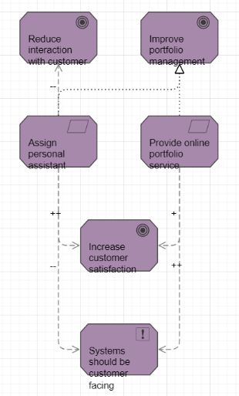
15 Goal Contribution - Example
30

Slide 32
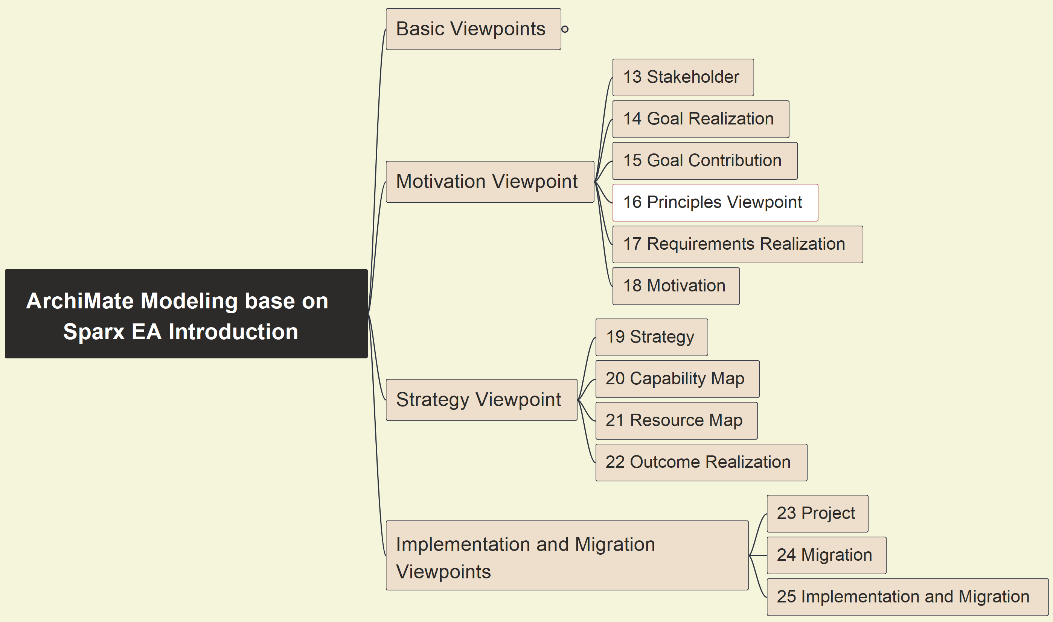
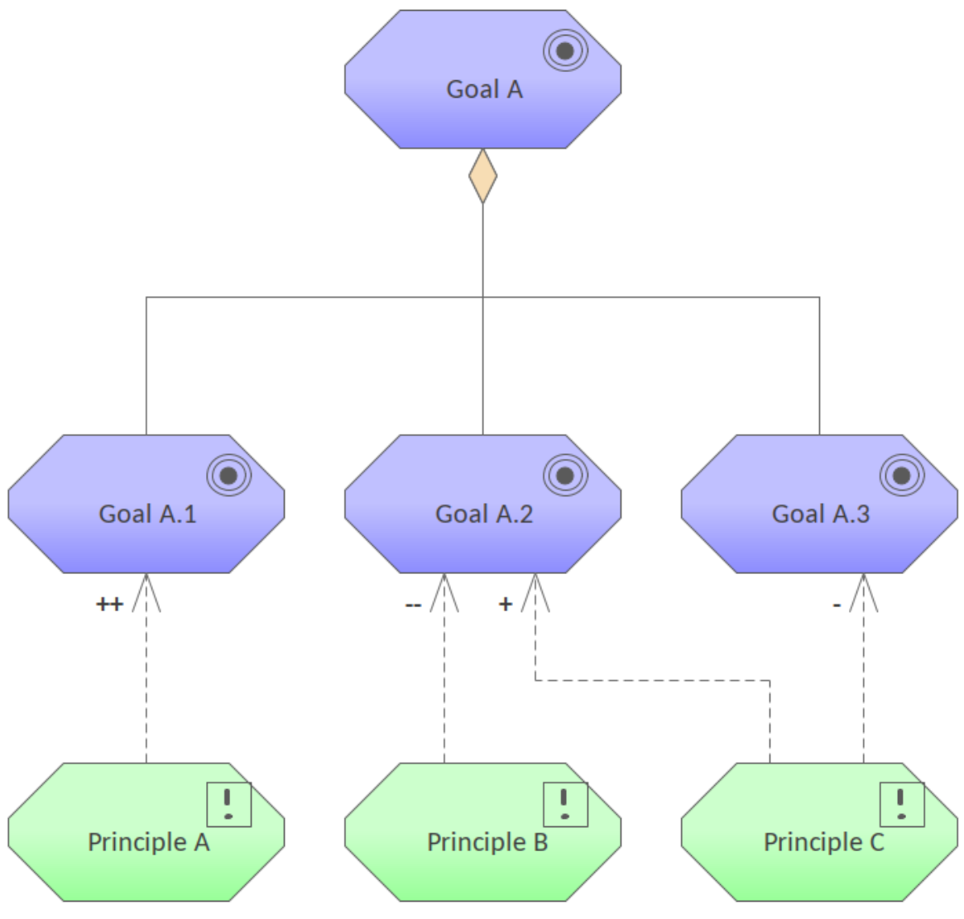
16 Principles - Pattern
31

Slide 33
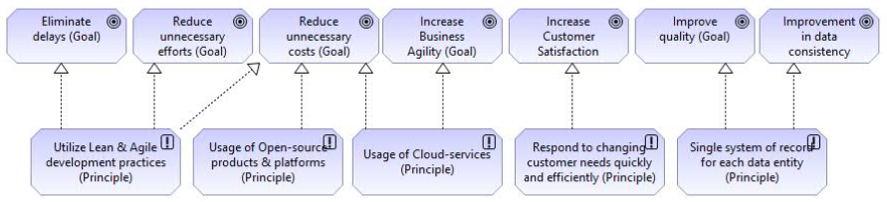
16 Principles – Example – system Thinking
32

Slide 34
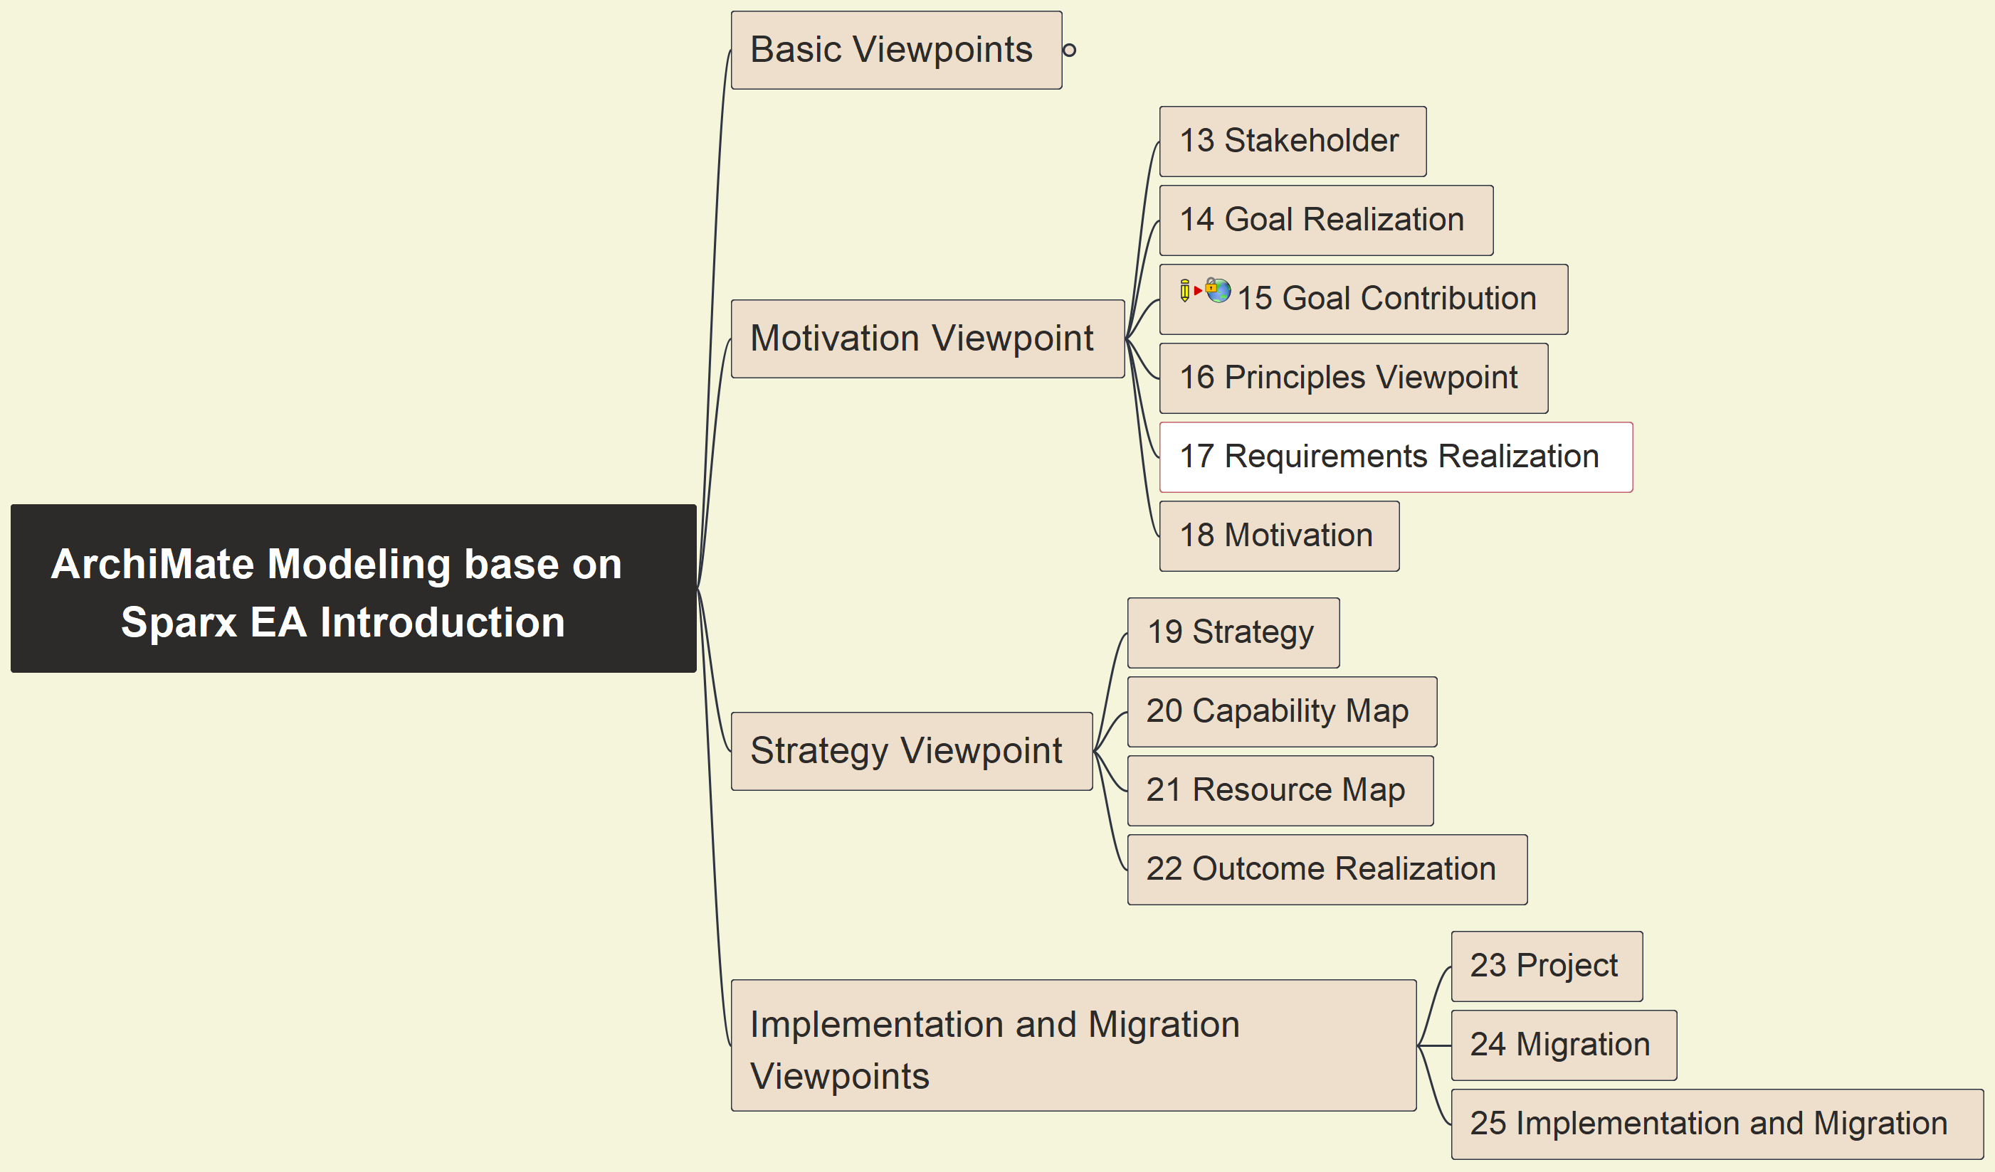
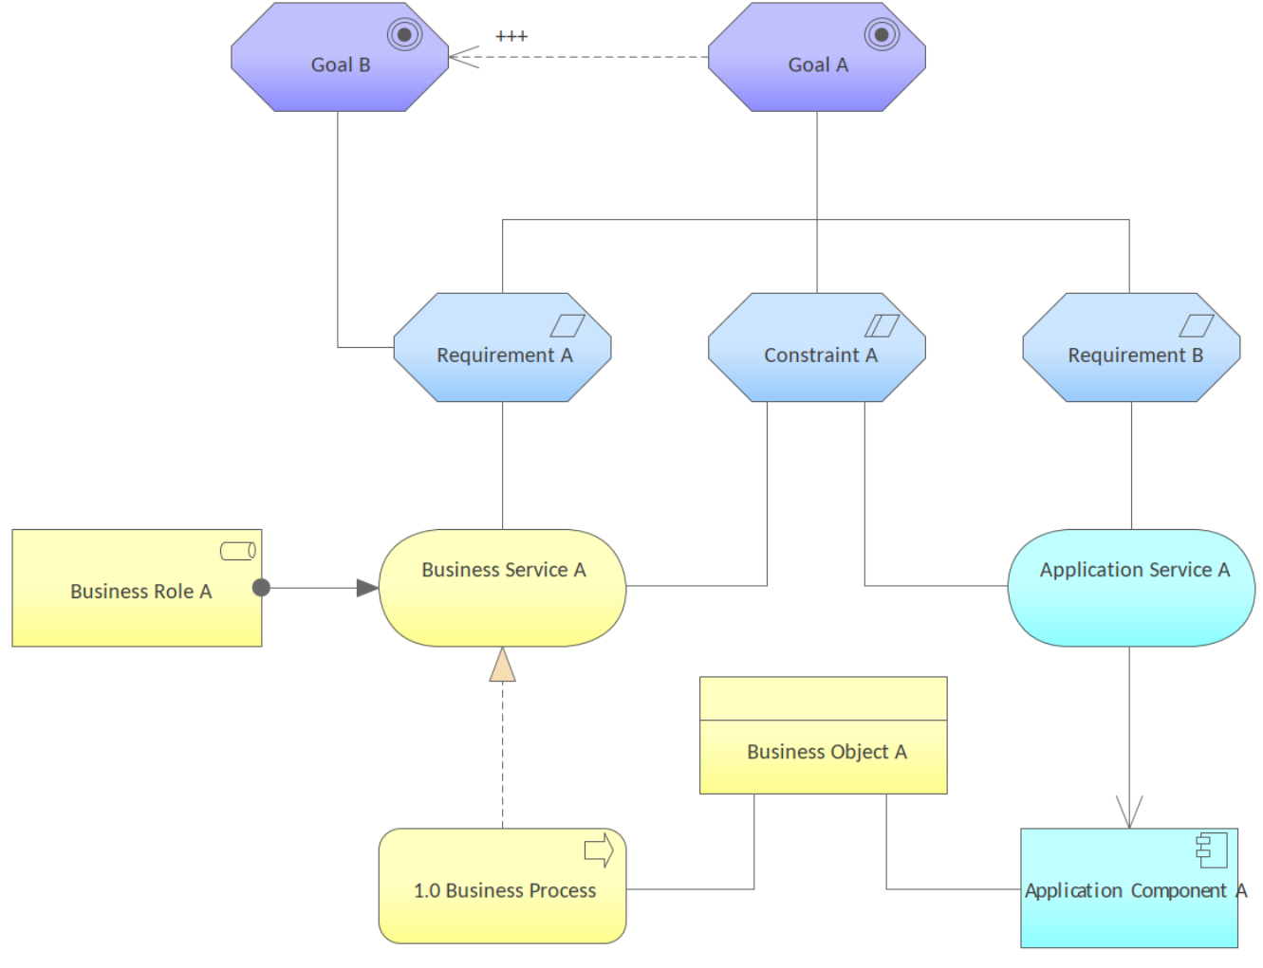
17 Requirements Realization - Pattern
33

Slide 35
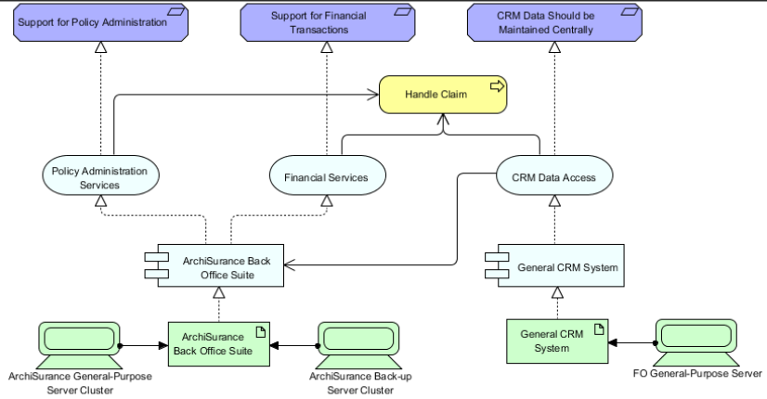
17 Requirements Realization - Example
34

Slide 36
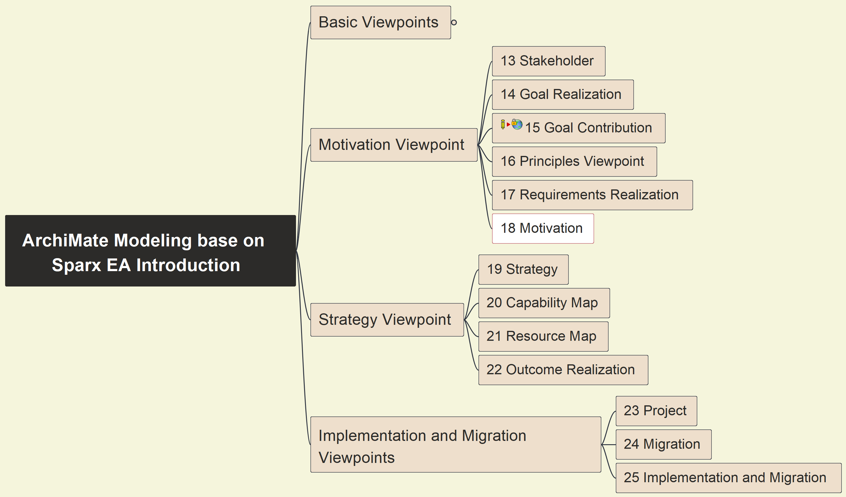

18 Motivation - Pattern
35

Slide 37

18 Motivation - Example
36

Slide 38


19 Strategy - Pattern
37

Slide 39

19 Strategy - Example
38

Slide 40


20 Capability Map - Pattern
39

Slide 41

20 Capability Map - Example
40

Slide 42


21 Resource Map - Pattern
41

Slide 43

21 Resource Map - Example
42

Slide 44


22 Outcome Motivation - Pattern
43

Slide 45

22 Outcome Motivation - Example
44

Slide 46


23 Project - Pattern
45

Slide 47

23 Project - Example
46

Slide 48


24 Migration - Pattern
47

Slide 49

24 Migration - Example
48

Slide 50


25 Implementation and Migration - Pattern
49

Slide 51

25 Implementation and Migration - Example
50

Slide 52




Closing and Summary
99

Slide 53





